Slide 1

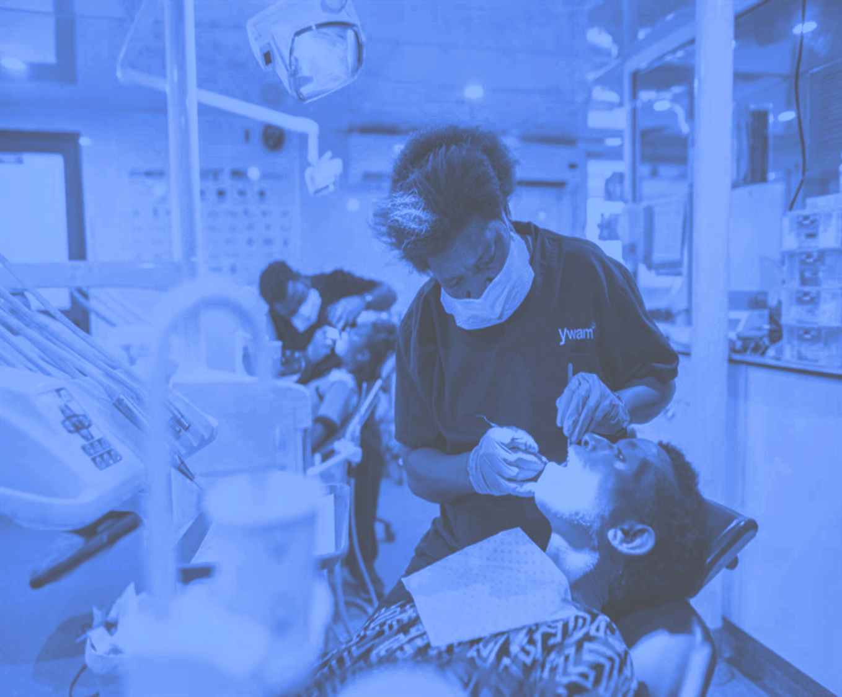
Dental Caries Part 1: Rethinking Decay
Understanding the Disease behind the Lesion
V. Kim Kutsch, DMD

Slide 2

Go Upstream

Slide 3
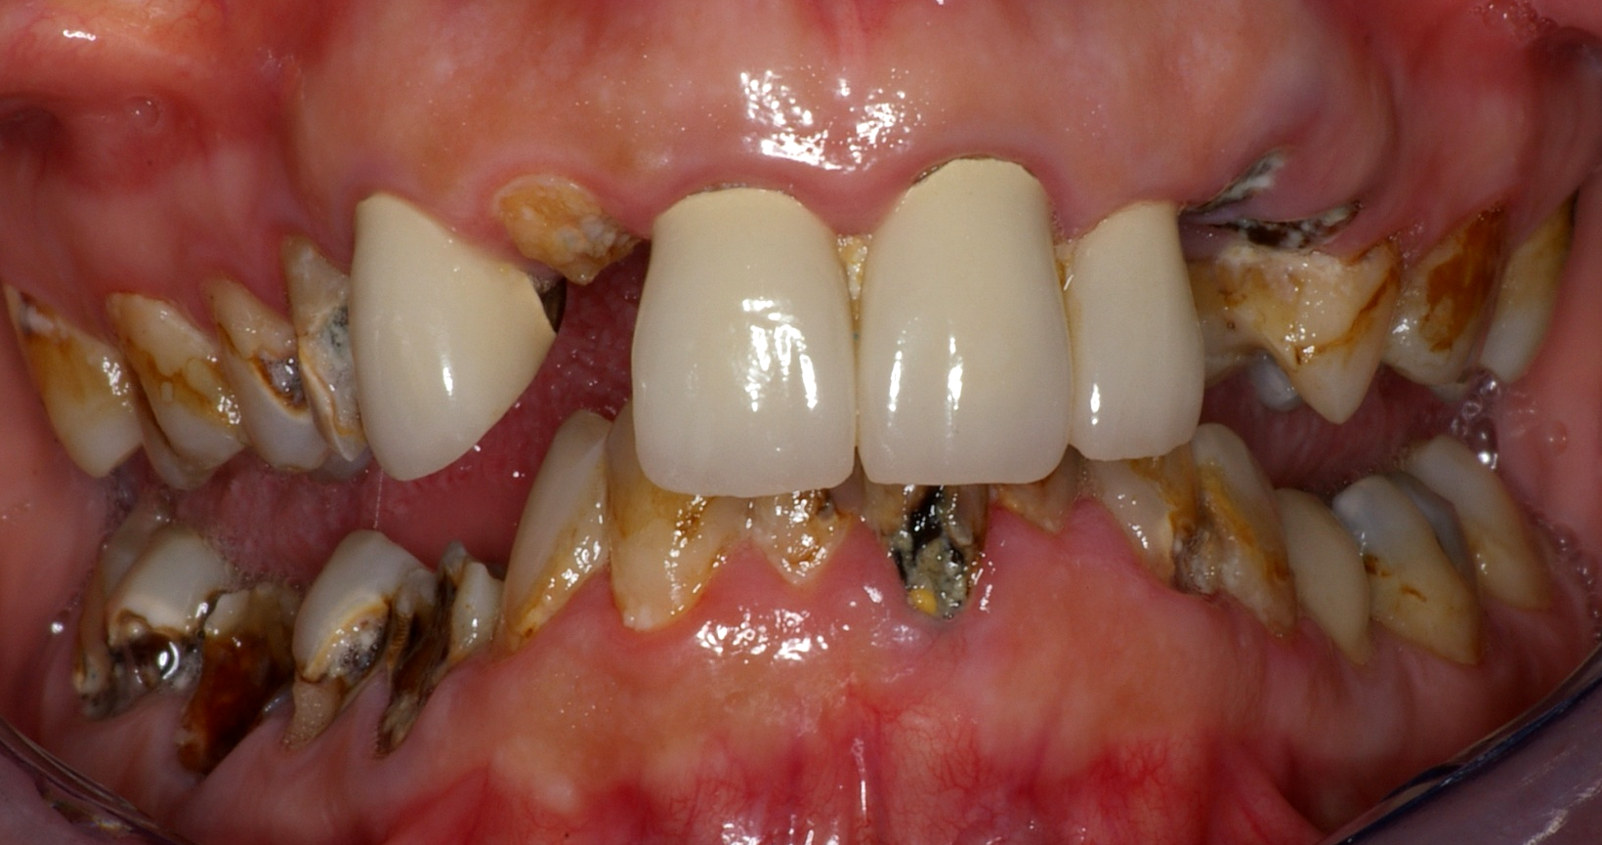
Cavities
Upstream
Disease
Teeth
Upstream
People
Notes:
This patient’s problem is not an infection caused by two bacteria, but rather a dysfunction of her biofilm resulting in prolonged periods of low pH and net mineral loss from the teeth. She came to me as a new patient in this present condition. Her previous dentist had placed 6 porcelain crowns on her maxillary incisors less than 2 years earlier. Already two of them had failed completely. This is the GV Black surgical model of treating this disease, and it doesn’t work.

Slide 4

P4 MEDICINE
Leroy Hood, MD 2010
0
“Combining technology, biology and a wellness approach, medicine is capable of providing care on a molecular, cellular and organ level to personalize each individual’s unique health experience. This information will make medical care radically more cost effective by personalizing care to each person’s unique biology and by treating the causes rather than the symptoms of disease.”

Slide 5

“Critical issues identified include the misconception of defining dental caries as a tooth or surface-level condition versus a person-level disease… accurate caries risk assessment at the population level and "precision dentistry" at the person level.”
Divaris K. Predicting Dental Caries Outcomes in Children: A "Risky" Concept. J Dent Res. 2015 Dec 8.

Slide 6
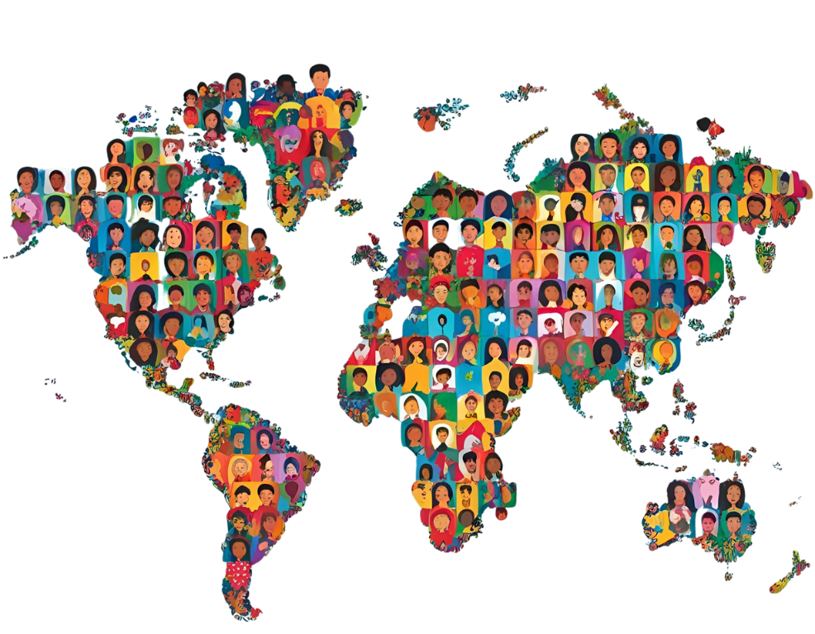
Disease Prevalence
“In 2010, untreated caries in permanent teeth was the most prevalent condition worldwide… and untreated caries in deciduous teeth was the 10th-most prevalent condition.”
Kassebaum NJ, Bernabé E, Dahiya M, Bhandari B, Murray CJ, et al. Global Burden of Untreated Caries: A Systematic Review and Metaregression. J Dent Res. 2015 May;94(5):650-658.
Notes:
7

Slide 7
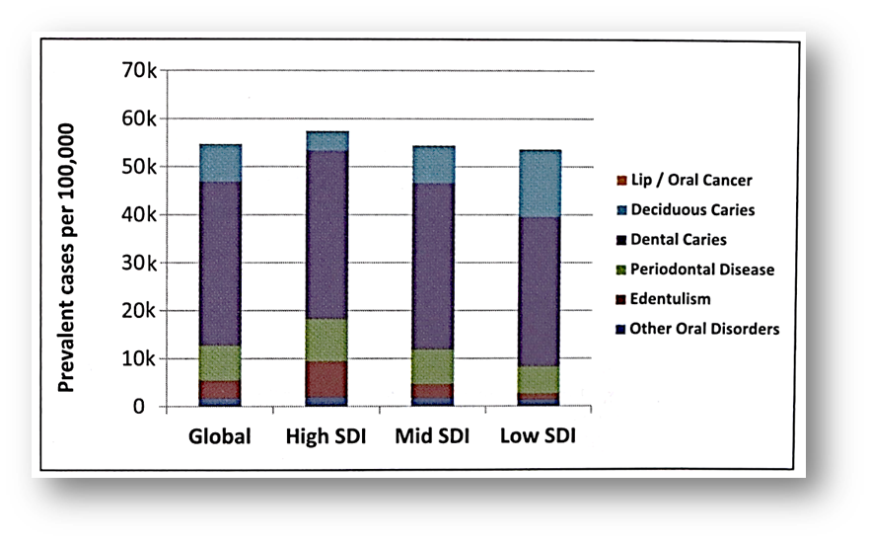
“Oral health has not improved in the last 25 years, and oral conditions remained a major public health challenge all over the world in 2015. Oral conditions remain a major and growing public health challenge.”
Kassebaum NJ, Smith AGC, Bernabé E, Fleming TD, Reynolds AE, et al. Global, Regional, and National Prevalence, Incidence, and Disability-Adjusted Life Years for Oral Conditions for 195 Countries, 1990-2015: A Systematic Analysis for the Global Burden of Diseases, Injuries, and Risk Factors. J Dent Res. 2017 Apr;96(4):380-387.
Notes:
Abstract
Objective: The present review aimed to systematically evaluate the occurrence of caries in patients with inflammatory bowel disease (IBD), either Crohn's disease (CD) or ulcerative colitis (UC), compared to healthy controls.
Materials and methods: MEDLINE (PubMed), Embase, Google Scholar, LILACS, and Cochrane Library electronic databases were screened. Caries experience was measured through the Decayed, Missing, Filled Teeth (DMFT) index. The weighted mean difference (WMD) with 95% confidence interval was calculated between IBD patients and healthy controls.
Results: Six studies were selected for the inclusion in the systematic review, 5 of which were also included in the quantitative synthesis of data. The WMD in the DMFT index between IBD and healthy subjects was 3.04 (1.52, 4.56) (p = 0.10). Subgroup analysis showed no difference (p = 0.31) between CD (2.52 [0.54, 4.49]) and UC (4.01 [1.52, 4.56]) subjects.
Conclusions: There is a remarkably higher past and present occurrence of dental caries in subjects with IBD than healthy controls. This result should encourage clinicians to include oral health preventive programs in the overall treatment plan of IBD patients.
8

Slide 8
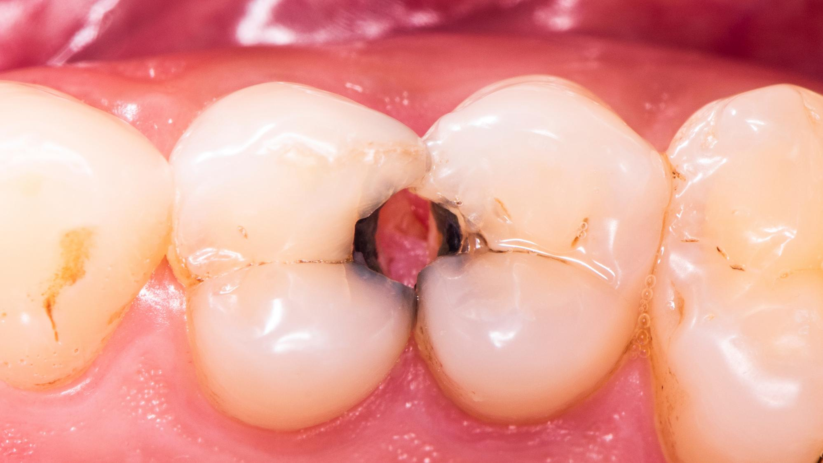
“Dental caries is a
  biofilm-mediated
  diet-modulated
  multifactorial
  non-communicable
  dynamic disease
resulting in net mineral
loss of dental hard tissues.”
Biofilm
Mediated
Host
Modulated
Dental
CARIES
Machiulskiene V, Campus g, Carvalho JC, Dige J, Ekstrand KR et al. Terminology of dental caries and dental caries management: consensus report by ORCA and IADR. Caries Research 2020. 54(1):7-14.

Slide 9

Bradshaw DJ, McKee AS, Marsh PD. Effects of carbohydrate pulses and pH on population shifts within oral microbial communities in vitro. J Dent Res. 1989 Sep;68(9):1298-302.
“Analysis of the data strongly suggests that the pH generated from carbohydrate metabolism, rather than carbohydrate availability per se, is responsible for the widely reported shifts in composition and metabolism of the oral microflora in vivo.”
Notes:
Abstract
Background: Dental caries risk factors have been expanded to not only emphasize biology, dietary and oral habits but also broader social determinants such as socioeconomic factors and the utilization of health services. The aim was to review sociobehavioural/cultural and socioeconomic determinants of dental caries in children residing in the Middle East and North Africa (MENA) region.
Methods: A search was conducted in the PubMed/Medline database and Google Scholar to identify studies published from 2000 to 2019 covering children using key search terms. In the initial stages, titles, abstracts and, if needed, full articles were screened for eligibility. In the final stage, all included articles were reassessed and read, and relevant data were extracted.
Results: Out of 600 initial articles, a total of 77 were included in this review, of which 74 were cross-sectional, 2 were longitudinal and one was a case-control study. The studies included a total of 94,491 participants in 14 countries across the MENA region. A majority used the World Health Organization scoring system to assess dental caries. The caries prevalence ranged between 17.2% and 88.8%, early childhood caries between 3% and 57% and decayed missing filled teeth (dmft) varied between 0.6 and 8.5 across the various age groups. Increased age, low maternal education, low overall socioeconomic status, decreased frequency of tooth brushing, low parental involvement, poor oral habits, infant feeding practices and sugar consumption were among the most prevalent determinants for increased risk of caries in the reviewed studies.
Conclusions: Dental caries was found to be high among children in many of the studies published from MENA. The key determinants of dental caries were found to include factors related to child characteristics, family background, oral hygiene and infant feeding and eating habits. The high dental caries prevalence emphasises the need to address the prevailing modifiable sociobehavioural and socioeconomic determinants by translating them into effective oral health prevention policies and programmes.

Slide 10
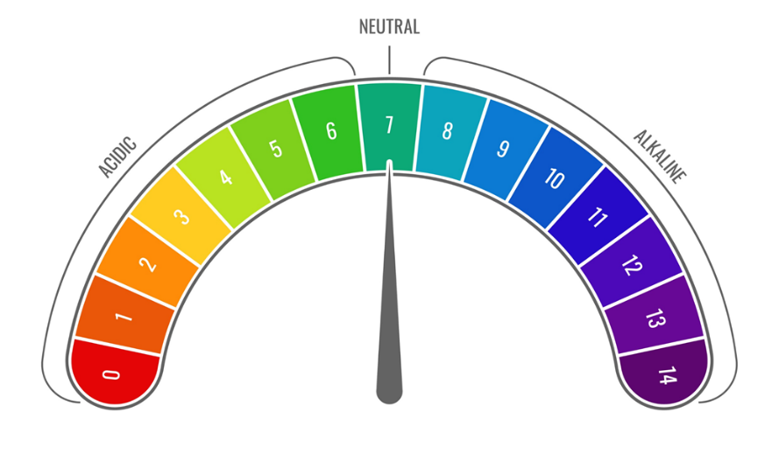
Why Is pH So Important?
Diet
Biofilm
Neutral
Saliva
acid
alkaline
neutral

Slide 11
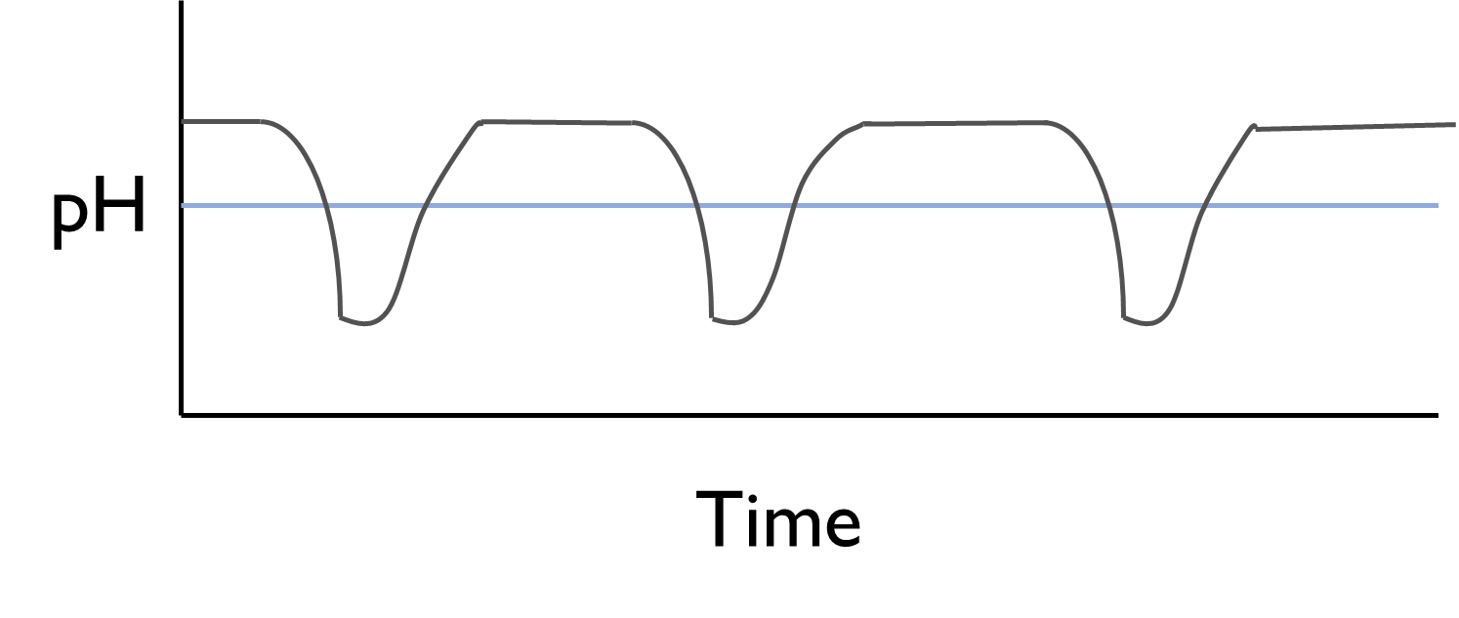
STEPHAN CURVE (Normal)

Slide 12
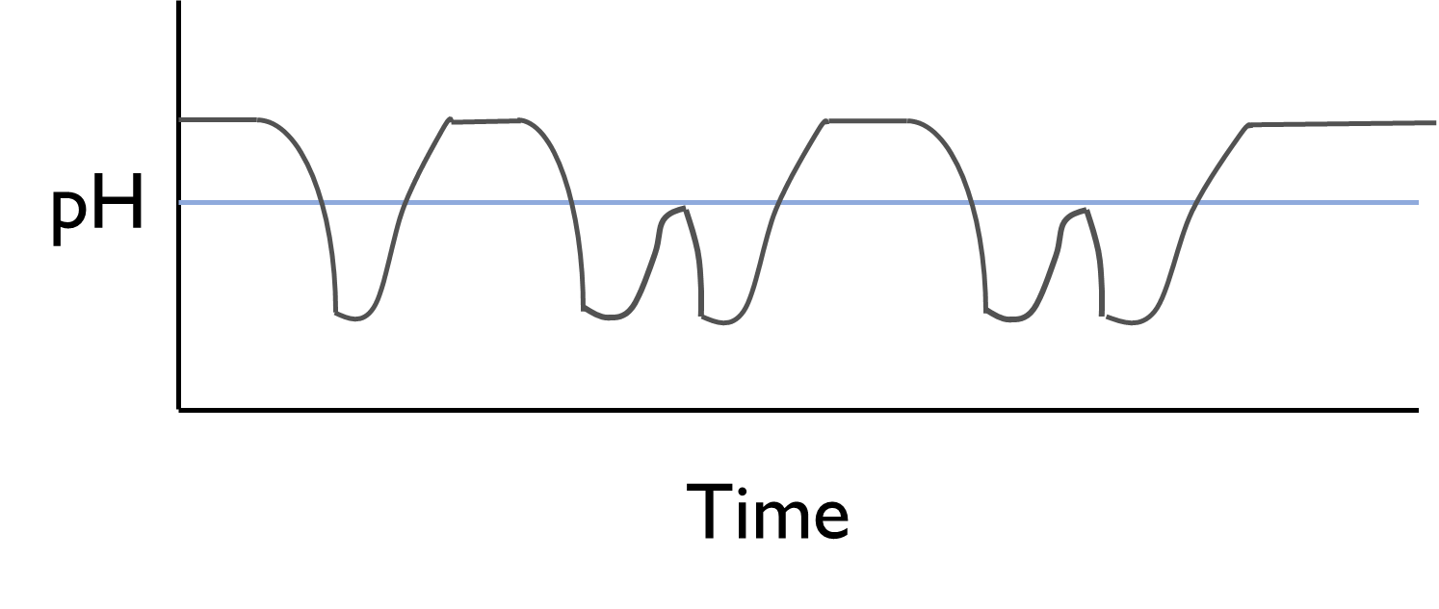
STEPHAN CURVE (Snacking)

Slide 13
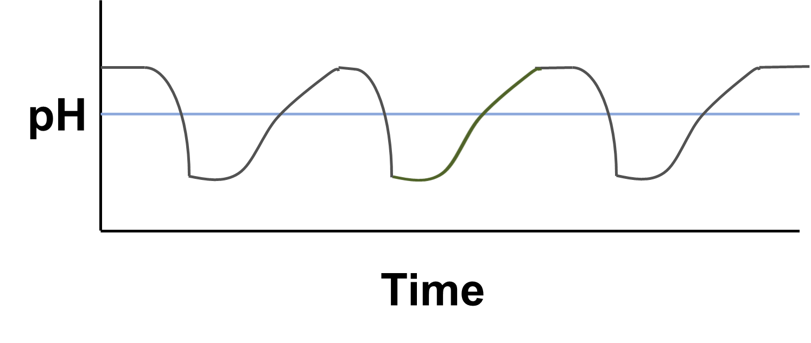
STEPHAN CURVE (Hyposalivation)

Slide 14
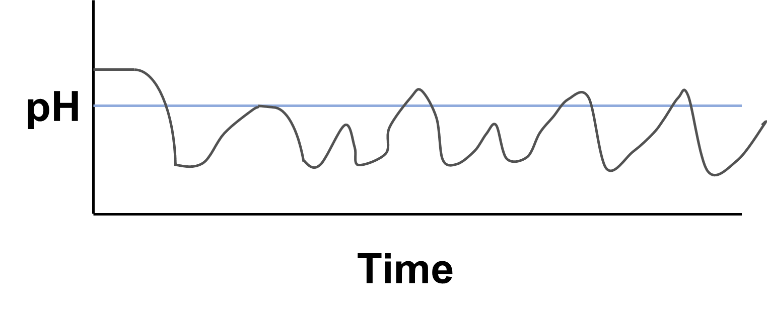
STEPHAN CURVE (S+H)

Slide 15
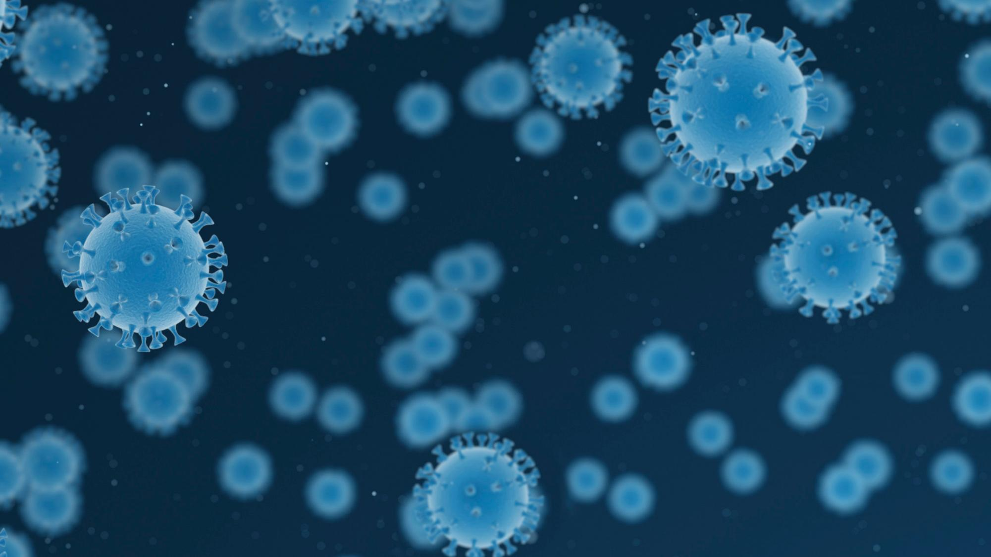
CURRENT BIOFILM MODEL
BIOFILM DYSBIOSIS
SYSTEMIC EFFECTS
HEREDITARY FACTORS

Slide 16

What Do We Know About the Microbiome?
Notes:
Abstract
Objective: The present review aimed to systematically evaluate the occurrence of caries in patients with inflammatory bowel disease (IBD), either Crohn's disease (CD) or ulcerative colitis (UC), compared to healthy controls.
Materials and methods: MEDLINE (PubMed), Embase, Google Scholar, LILACS, and Cochrane Library electronic databases were screened. Caries experience was measured through the Decayed, Missing, Filled Teeth (DMFT) index. The weighted mean difference (WMD) with 95% confidence interval was calculated between IBD patients and healthy controls.
Results: Six studies were selected for the inclusion in the systematic review, 5 of which were also included in the quantitative synthesis of data. The WMD in the DMFT index between IBD and healthy subjects was 3.04 (1.52, 4.56) (p = 0.10). Subgroup analysis showed no difference (p = 0.31) between CD (2.52 [0.54, 4.49]) and UC (4.01 [1.52, 4.56]) subjects.
Conclusions: There is a remarkably higher past and present occurrence of dental caries in subjects with IBD than healthy controls. This result should encourage clinicians to include oral health preventive programs in the overall treatment plan of IBD patients.

Slide 17
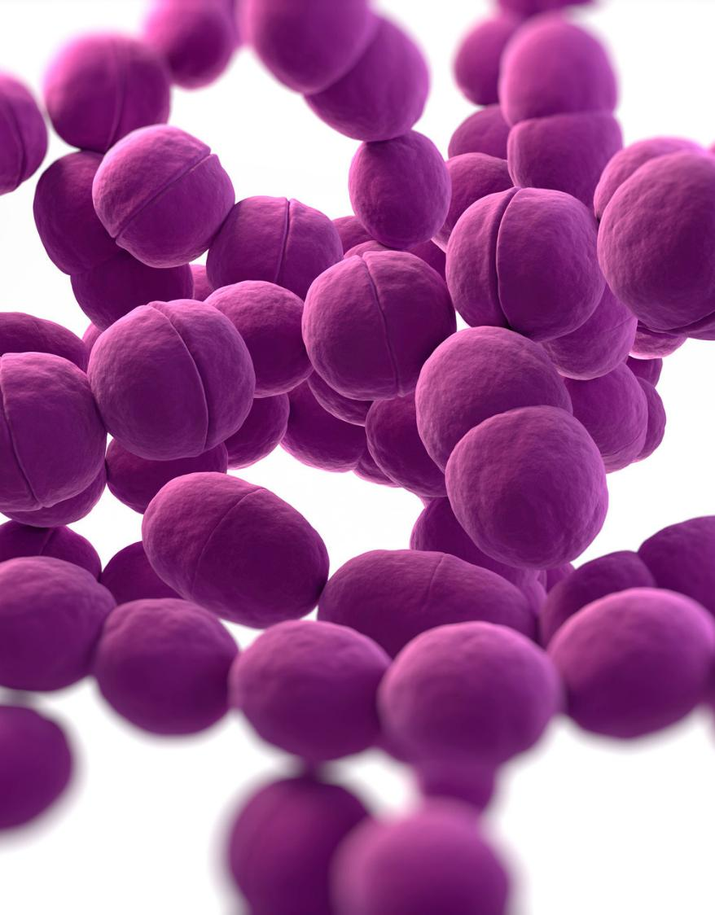
Johansson I, Witkowska E, Kaveh B, Lif Holgerson P, Tanner AC. The Microbiome in Populations with a Low and High Prevalence of Caries. J Dent Res. 2016 Jan;95(1):80-6.
Prevention Reduces Pathogen Impact
“Hence, the role of Mutans streptococci as a primary caries pathogen appears less pronounced in populations with prevention programs compared to populations lacking caries treatment and prevention strategies.”
Notes:
Abstract
Background: Dental caries risk factors have been expanded to not only emphasize biology, dietary and oral habits but also broader social determinants such as socioeconomic factors and the utilization of health services. The aim was to review sociobehavioural/cultural and socioeconomic determinants of dental caries in children residing in the Middle East and North Africa (MENA) region.
Methods: A search was conducted in the PubMed/Medline database and Google Scholar to identify studies published from 2000 to 2019 covering children using key search terms. In the initial stages, titles, abstracts and, if needed, full articles were screened for eligibility. In the final stage, all included articles were reassessed and read, and relevant data were extracted.
Results: Out of 600 initial articles, a total of 77 were included in this review, of which 74 were cross-sectional, 2 were longitudinal and one was a case-control study. The studies included a total of 94,491 participants in 14 countries across the MENA region. A majority used the World Health Organization scoring system to assess dental caries. The caries prevalence ranged between 17.2% and 88.8%, early childhood caries between 3% and 57% and decayed missing filled teeth (dmft) varied between 0.6 and 8.5 across the various age groups. Increased age, low maternal education, low overall socioeconomic status, decreased frequency of tooth brushing, low parental involvement, poor oral habits, infant feeding practices and sugar consumption were among the most prevalent determinants for increased risk of caries in the reviewed studies.
Conclusions: Dental caries was found to be high among children in many of the studies published from MENA. The key determinants of dental caries were found to include factors related to child characteristics, family background, oral hygiene and infant feeding and eating habits. The high dental caries prevalence emphasises the need to address the prevailing modifiable sociobehavioural and socioeconomic determinants by translating them into effective oral health prevention policies and programmes.

Slide 18
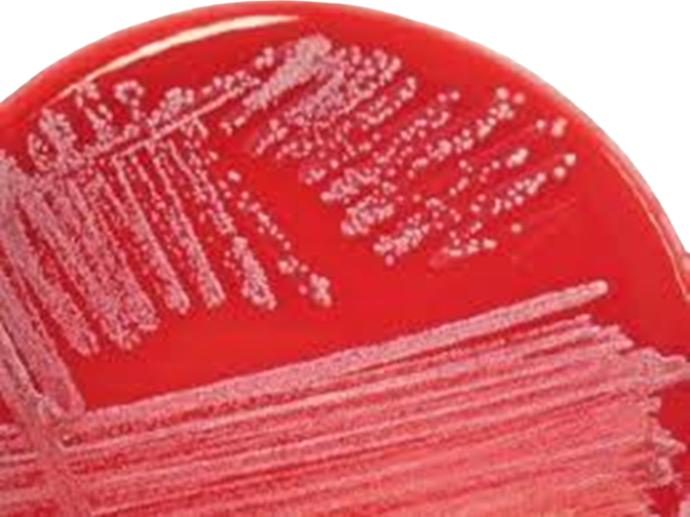
Beyond S. mutans: Meet S. wiggsiae
“Scardovia wiggsiae was significantly associated with severe-ECC children in the presence and absence of S. mutans detection. The major caries-associated species were S. mutans and S. wiggsiae, the latter of which is a candidate as a newly recognized caries pathogen.”
Tanner AC, Mathney JM, Kent RL Jr, et al. Cultivable Anaerobic Microbiota of Severe Early Childhood Caries. J Clin Microbiol 2011 Apr;49(4):1464-74.

Slide 19

Treat the Decay, Change the Bugs
“We conclude that several species including S. wiggsiae and Slakia exigua are associated with the etiology of advanced dental caries, that successful treatment is accompanied by a change in the microbiota, and that severe ECC is diverse, with influences from selected bacteria or from diet.”
Tanner ACR, Kent RL, Lif Holgerson P, et al. Microbiota of severe early childhood caries before and after therapy. JDR November 2011. 90(11):1298-1305.

Slide 20

High Candida = High Risk in Kids
“A high salivary Candida carriage rate and the presence of specific species of this fungus (such as C. albicans, C. dubliniensis and C. Parapsilosis) appear to be related to the severity of caries experienced by preschool children.”
Lozano Moraga CP, Rodríguez Martínez GA, Lefimil Puente CA, Morales Bozo IC, et al. Prevalence of Candida albicans and carriage of Candida non-albicans in the saliva of preschool children, according to their caries status. Acta Odontol Scand. 2017 Jan;75(1):30-35. 61 2-5 yro. ICDAS

Slide 21
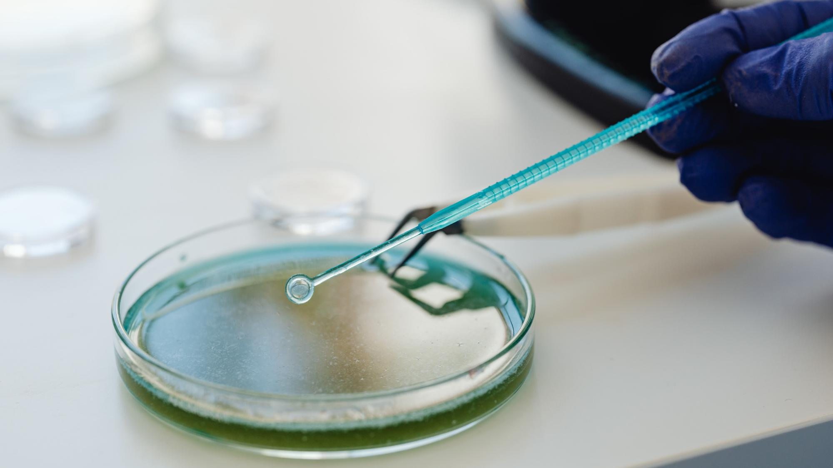
Holistic microbial community
“Dental plaque, previously considered a polymicrobial community of unspecific pathogenicity, is recognized as microbial biofilms with healthy, cariogenic, or periodontopathogenic profiles, resulting from specific ecologic determinants and host factors. The "one pathogen, one disease" paradigm of oral infections has been replaced by a holistic concept of a microbial community as the entity of pathogenicity.”
Colombo APV, Tanner ACR, The Role of Bacterial Biofilms in Dental Caries and Periodontal and Peri-implant Diseases: A Historical Perspective. J Dent Res. 2019 Apr;98(4):373-385. doi: 10.1177/0022034519830686.

Slide 22
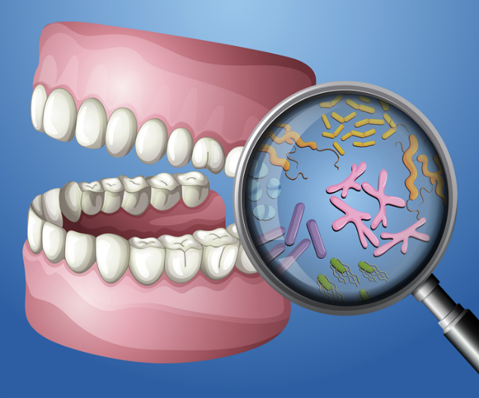
Individualized Care
“The oral microbiome of each person is quite distinct. Consequently, commonly taken measures for disease prevention cannot be exactly the same for other individuals. The chance for developing tooth decay in individuals is dependent on factors such as immune system and oral microbiome.”
Mosaddad SA, Tahmasebi E, Yazdanian A, Rezvani MB, Seifalian A. Oral microbial biofilms: an update. Eur J Clin Microbiol Infect Dis. 2019 Aug 1. doi: 10.1007/s10096-019-03641-9.
Notes:
Abstract
Background: Dental caries risk factors have been expanded to not only emphasize biology, dietary and oral habits but also broader social determinants such as socioeconomic factors and the utilization of health services. The aim was to review sociobehavioural/cultural and socioeconomic determinants of dental caries in children residing in the Middle East and North Africa (MENA) region.
Methods: A search was conducted in the PubMed/Medline database and Google Scholar to identify studies published from 2000 to 2019 covering children using key search terms. In the initial stages, titles, abstracts and, if needed, full articles were screened for eligibility. In the final stage, all included articles were reassessed and read, and relevant data were extracted.
Results: Out of 600 initial articles, a total of 77 were included in this review, of which 74 were cross-sectional, 2 were longitudinal and one was a case-control study. The studies included a total of 94,491 participants in 14 countries across the MENA region. A majority used the World Health Organization scoring system to assess dental caries. The caries prevalence ranged between 17.2% and 88.8%, early childhood caries between 3% and 57% and decayed missing filled teeth (dmft) varied between 0.6 and 8.5 across the various age groups. Increased age, low maternal education, low overall socioeconomic status, decreased frequency of tooth brushing, low parental involvement, poor oral habits, infant feeding practices and sugar consumption were among the most prevalent determinants for increased risk of caries in the reviewed studies.
Conclusions: Dental caries was found to be high among children in many of the studies published from MENA. The key determinants of dental caries were found to include factors related to child characteristics, family background, oral hygiene and infant feeding and eating habits. The high dental caries prevalence emphasises the need to address the prevailing modifiable sociobehavioural and socioeconomic determinants by translating them into effective oral health prevention policies and programmes.
10

Slide 23

Does Dental Caries Have Systemic Effects?
WELLNESSDENTISTRYNETWORK.COM
Notes:
Abstract
Objective: The present review aimed to systematically evaluate the occurrence of caries in patients with inflammatory bowel disease (IBD), either Crohn's disease (CD) or ulcerative colitis (UC), compared to healthy controls.
Materials and methods: MEDLINE (PubMed), Embase, Google Scholar, LILACS, and Cochrane Library electronic databases were screened. Caries experience was measured through the Decayed, Missing, Filled Teeth (DMFT) index. The weighted mean difference (WMD) with 95% confidence interval was calculated between IBD patients and healthy controls.
Results: Six studies were selected for the inclusion in the systematic review, 5 of which were also included in the quantitative synthesis of data. The WMD in the DMFT index between IBD and healthy subjects was 3.04 (1.52, 4.56) (p = 0.10). Subgroup analysis showed no difference (p = 0.31) between CD (2.52 [0.54, 4.49]) and UC (4.01 [1.52, 4.56]) subjects.
Conclusions: There is a remarkably higher past and present occurrence of dental caries in subjects with IBD than healthy controls. This result should encourage clinicians to include oral health preventive programs in the overall treatment plan of IBD patients.

Slide 24
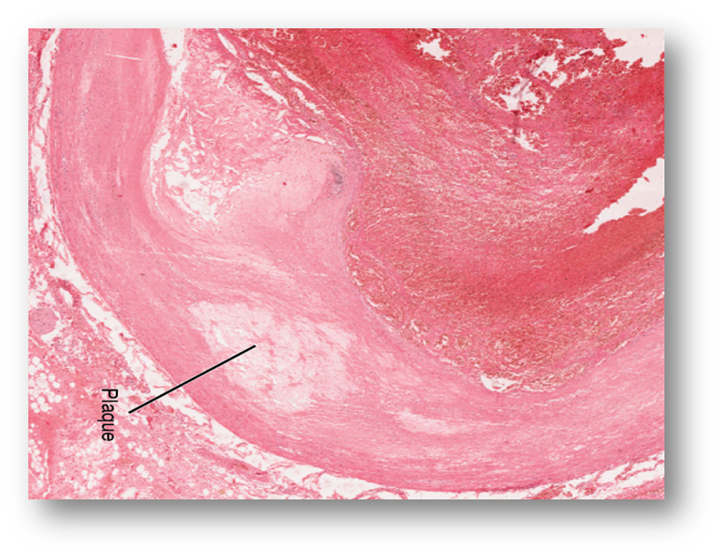
Dental Care Doesn’t Stop with Dentures
“Most of the patients were edentulous (76.9%). SM, PI, PG and TD were detected in 100.0%, 92.0%, 15.3% and 30.7% of the oral samples, respectively. SM was the most prevalent targeted bacteria in atherosclerotic plaques, detected in 100% of the samples.”
Fernandes CP, Oliveira FAF, Silva PGDB, Alves APNN, Mota MRL, et al. Molecular analysis of oral bacteria in dental biofilm and atherosclerotic plaques of patients with vascular disease. International Journal of Cardiology. 2014. 174(3):71-712. 13 patients

Slide 25
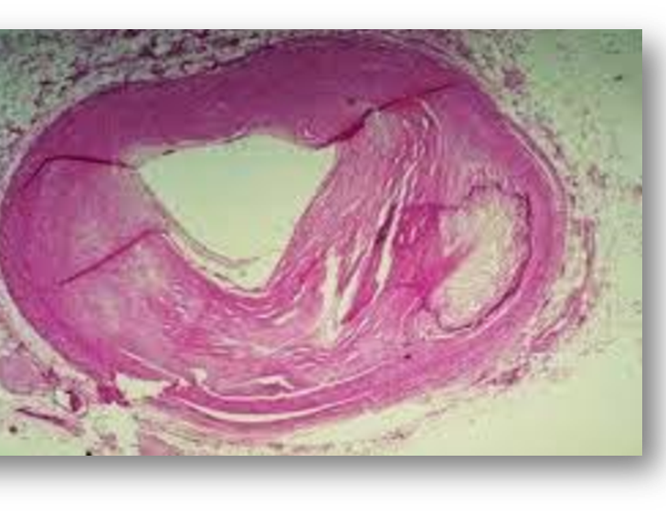
A Matter of the Heart
“The micro-organism most frequently detected in heart valve samples was the
S. mutans (89.3%), followed by P. intermedia (19.1%), P. gingivalis (4.2%), and T. denticola (2.1%).”
Oliveira FA, Forte CP, Silva PG, Lopes CB, Montenegro RC et al. Molecular Analysis of Oral Bacteria in Heart Valve of Patients With Cardiovascular Disease by Real-Time Polymerase Chain Reaction. Medicine (Baltimore). 2015 Nov;94(47):e2067. 42 ad CVD
.

Slide 26

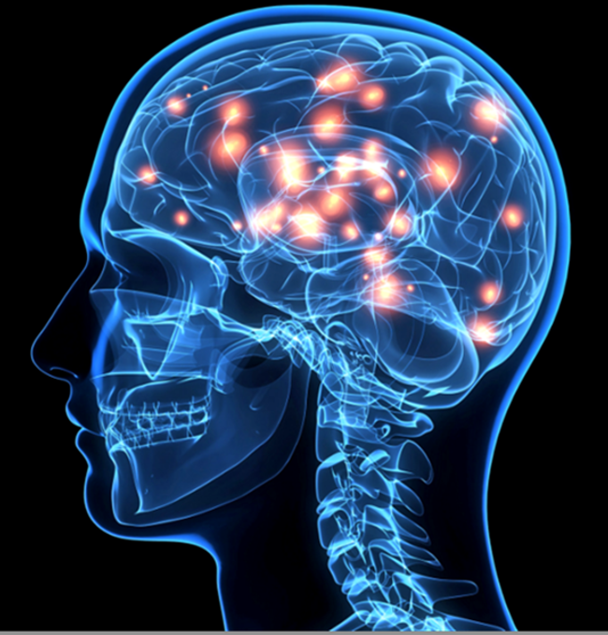
“A statistically significant high Cnm-positive rate was observed in patients with CES, non-CES infarct, ICH, and RIA. Specific types of oral SM can be a risk factor for cardioembolic infarct, intracerebral hemorrhage, and intracranial aneurysm rupture.”
Inenaga C, Hokamura K, Nakano K, Nomura R, Naka S, et al. A Potential New Risk Factor for Stroke: Streptococcus Mutans With Collagen-Binding Protein. World Neurosurg. 2018 May;113:e77-e81. doi: 10.1016/j.wneu.2018.01.158. Epub 2018 Feb 6. Saliva 429 / 79 health vol.

Slide 27

From Mouth to Heart
“The present study adds considerable evidence for the involvement of oral commensal bacteria S. mutans strain in human CVDs via its ability to colonize and populate in oral environment and spread throughout bloodstream to cardiovascular system forming biofilms and atherosclerotic plaques.”
Adil Ateyah A. A. AL-Nasrawi1 , Haider Ali Muhammed1 , Ali Kadhim Aljarah1Linkage between Cariogenic Streptococcus Mutans and Atherosclerotic Plaques of Cardiovascular Disease Patients in Iraqi Population. Medico-legal Update, July-September 2020. 20(3): 941-947. 86 ad
Notes:
Abstract:This study was done to identify the correlation between cariogenic S. mutans and CVD patients of Iraqi population. Materials and Method: Eighty six cardiovascular Iraqi patients between (24-70) years old were investigated for their association with cariogenic S. mutans. Pathological samples of vascular and heart valve biopsies and atherosclerotic plaques from the catheter tips of the diagnostic and therapeutic catheters of CVD patients were analyzed with molecular PCR technique with two types of primers, 16s universal primer and S. mutans serotype-specific primer sets genotyping was performed to determine the linkage between cariogenic S.mutans and CVD patients in Iraqi population. Results: DNA samples of cariogenic S. mutans was specified in 60 / 86(69.7%) of the enrolled cardiovascular disease patients, distributed according to the gender between 42/60 (70 %) in males and 18/60 (30%) in (16) females and according to the age between 33/60(55 %) of the positive patients were at 24-60 years and 27/60(45 %) of the positive patients were > 60 years old. (16) (PDF) Linkage between Cariogenic Streptococcus Mutans and Atherosclerotic Plaques of Cardiovascular Disease Patients in Iraqi Population. Available from: https://www.researchgate.net/publication/343040964_Linkage_between_Cariogenic_Streptococcus_Mutans_and_Atherosclerotic_Plaques_of_Cardiovascular_Disease_Patients_in_Iraqi_Population [accessed Sep 11 2022].(PDF) Linkage between Cariogenic Streptococcus Mutans and Atherosclerotic Plaques of Cardiovascular Disease Patients in Iraqi Population. Available from: https://www.researchgate.net/publication/343040964_Linkage_between_Cariogenic_Streptococcus_Mutans_and_Atherosclerotic_Plaques_of_Cardiovascular_Disease_Patients_in_Iraqi_Population [accessed Sep 11 2022].
15

Slide 28

What Role Do Genetics Play?
Notes:
Abstract
Objective: The present review aimed to systematically evaluate the occurrence of caries in patients with inflammatory bowel disease (IBD), either Crohn's disease (CD) or ulcerative colitis (UC), compared to healthy controls.
Materials and methods: MEDLINE (PubMed), Embase, Google Scholar, LILACS, and Cochrane Library electronic databases were screened. Caries experience was measured through the Decayed, Missing, Filled Teeth (DMFT) index. The weighted mean difference (WMD) with 95% confidence interval was calculated between IBD patients and healthy controls.
Results: Six studies were selected for the inclusion in the systematic review, 5 of which were also included in the quantitative synthesis of data. The WMD in the DMFT index between IBD and healthy subjects was 3.04 (1.52, 4.56) (p = 0.10). Subgroup analysis showed no difference (p = 0.31) between CD (2.52 [0.54, 4.49]) and UC (4.01 [1.52, 4.56]) subjects.
Conclusions: There is a remarkably higher past and present occurrence of dental caries in subjects with IBD than healthy controls. This result should encourage clinicians to include oral health preventive programs in the overall treatment plan of IBD patients.

Slide 29

Gene Variant Linked to Higher Risk of Tooth Decay
“300 individuals tested for polymorphism of gene beta defensin 1 (DEFB1) Saliva contained one of three variants. Individuals who carries a G-20A copy had DMFT and DMFS scores that were five-times higher than for people who had other variants.”
Ozturk A, Famili P, Vieira AR. The antimicrobial peptide DEFB1 is associated with caries. J Dent Res. 2010 Jun;89(6):631-6.

Slide 30

Your Sweet Tooth Might Be in Your Genes
“Dental caries is influenced by a complex interplay of genetic and environmental factors, including dietary habits…Statistically, significant associations were seen in TAS2R38 (bitter) and TAS1R2 (sweet) for caries risk and/or protection.”
Wendell S, Wang X, Brown M, Cooper ME et al. Taste genes associated with dental caries. JDR Nov 2010. 89(11):1198-1202.

Slide 31
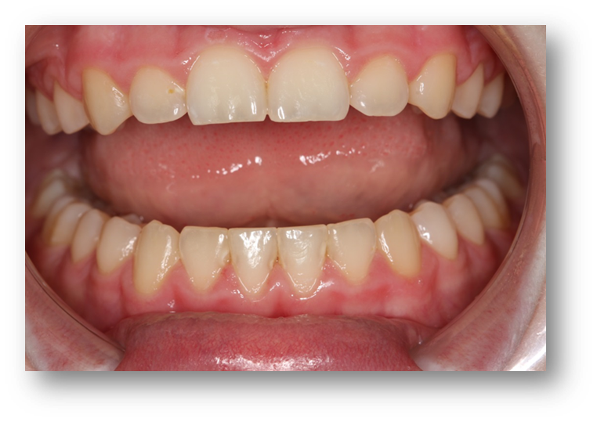
Host Defense Gene LYZL2 Associated with Caries
“We identified a significant genetic association between dental caries of the anterior mandibular teeth and LYZL2, which codes a bacteriolytic agent thought to be involved in host defense.”
Shaffer JR, Feingold E, et al. GENOME WIDE ASSOCIATION STUDY of Dental Caries Patterns in the Permanent Dentition. Dent Res. 2013 Jan;92(1):38-44. 920/18-75/518,997GS

Slide 32
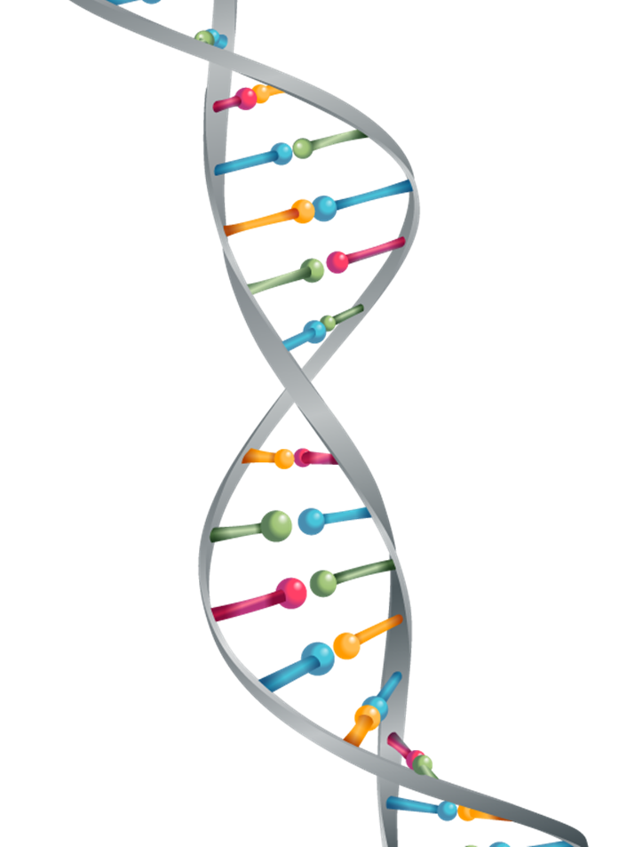
Enamel Formation Genes: 7 (AMELX, ENAM)
Immune Response Genes: 7
(BDEF1, CD14)
Saliva Genes: 2 (AQP5, PRH1)
Other Genes: 11 (TAS2R38, MMP13)
47 novel and conditionally-independent risk loci for dental caries
CURRENT DENTAL CARIES GENES
Notes:
Abstract
Objective: The present review aimed to systematically evaluate the occurrence of caries in patients with inflammatory bowel disease (IBD), either Crohn's disease (CD) or ulcerative colitis (UC), compared to healthy controls.
Materials and methods: MEDLINE (PubMed), Embase, Google Scholar, LILACS, and Cochrane Library electronic databases were screened. Caries experience was measured through the Decayed, Missing, Filled Teeth (DMFT) index. The weighted mean difference (WMD) with 95% confidence interval was calculated between IBD patients and healthy controls.
Results: Six studies were selected for the inclusion in the systematic review, 5 of which were also included in the quantitative synthesis of data. The WMD in the DMFT index between IBD and healthy subjects was 3.04 (1.52, 4.56) (p = 0.10). Subgroup analysis showed no difference (p = 0.31) between CD (2.52 [0.54, 4.49]) and UC (4.01 [1.52, 4.56]) subjects.
Conclusions: There is a remarkably higher past and present occurrence of dental caries in subjects with IBD than healthy controls. This result should encourage clinicians to include oral health preventive programs in the overall treatment plan of IBD patients.
20

Slide 33

Caries Risk Management: Pattern Recognition
Notes:
Abstract
Objective: The present review aimed to systematically evaluate the occurrence of caries in patients with inflammatory bowel disease (IBD), either Crohn's disease (CD) or ulcerative colitis (UC), compared to healthy controls.
Materials and methods: MEDLINE (PubMed), Embase, Google Scholar, LILACS, and Cochrane Library electronic databases were screened. Caries experience was measured through the Decayed, Missing, Filled Teeth (DMFT) index. The weighted mean difference (WMD) with 95% confidence interval was calculated between IBD patients and healthy controls.
Results: Six studies were selected for the inclusion in the systematic review, 5 of which were also included in the quantitative synthesis of data. The WMD in the DMFT index between IBD and healthy subjects was 3.04 (1.52, 4.56) (p = 0.10). Subgroup analysis showed no difference (p = 0.31) between CD (2.52 [0.54, 4.49]) and UC (4.01 [1.52, 4.56]) subjects.
Conclusions: There is a remarkably higher past and present occurrence of dental caries in subjects with IBD than healthy controls. This result should encourage clinicians to include oral health preventive programs in the overall treatment plan of IBD patients.

Slide 34
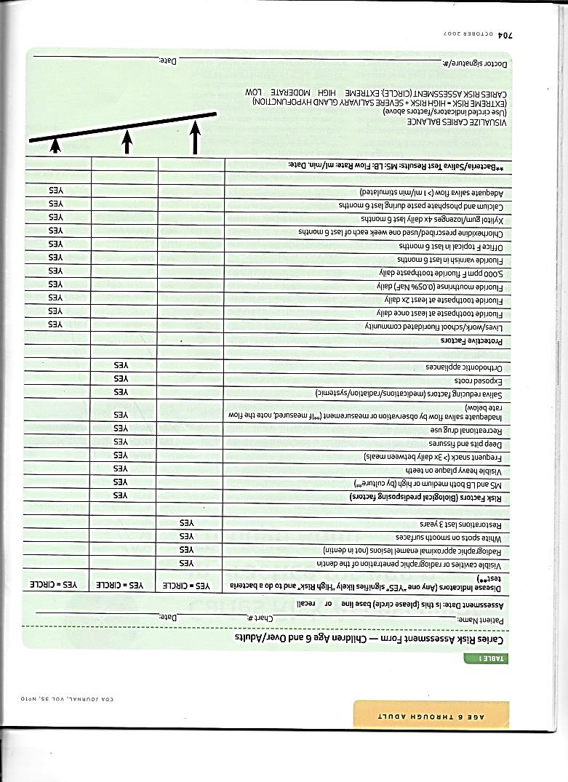
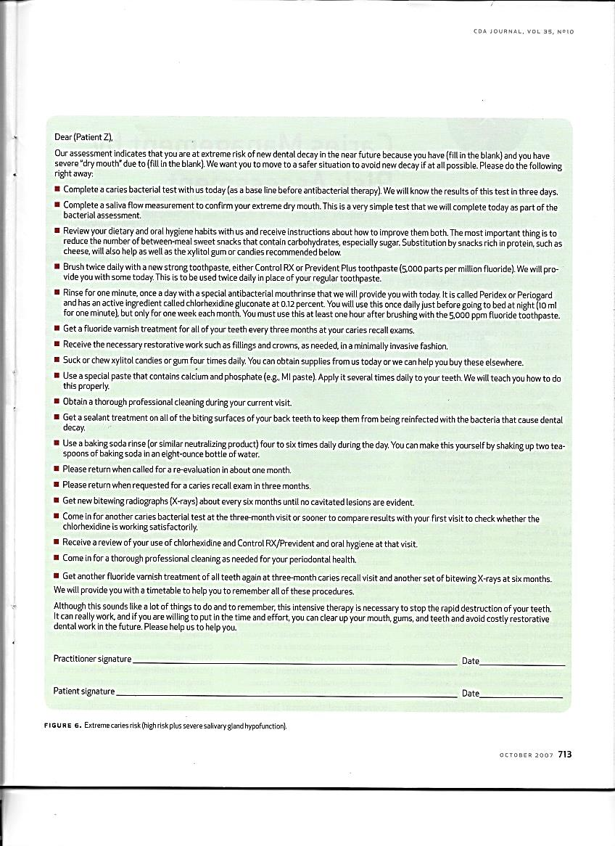
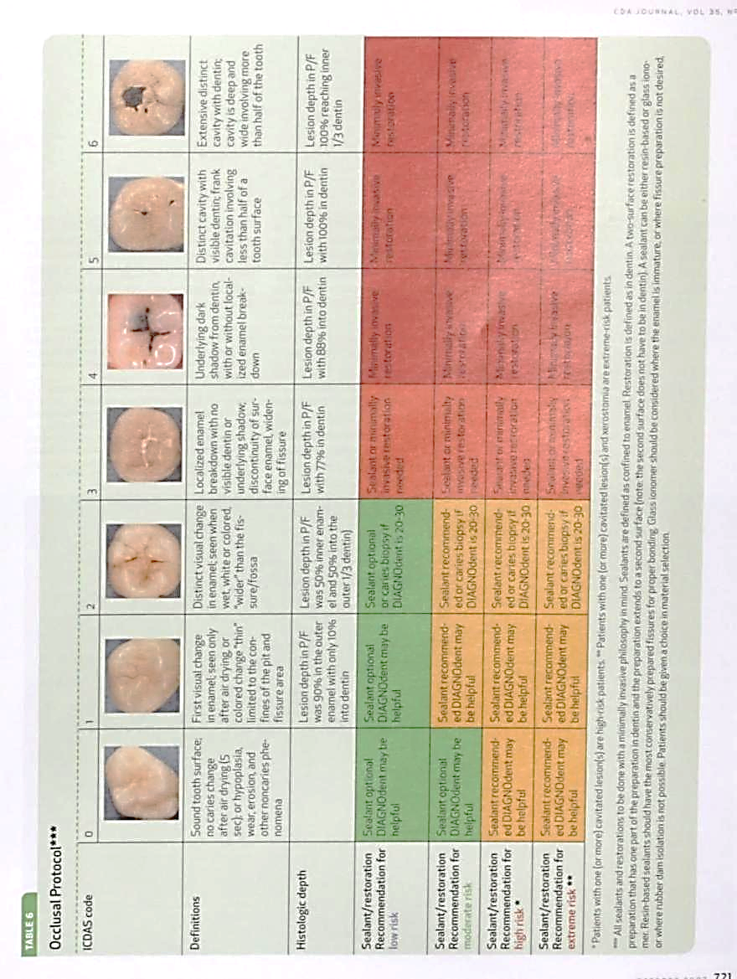
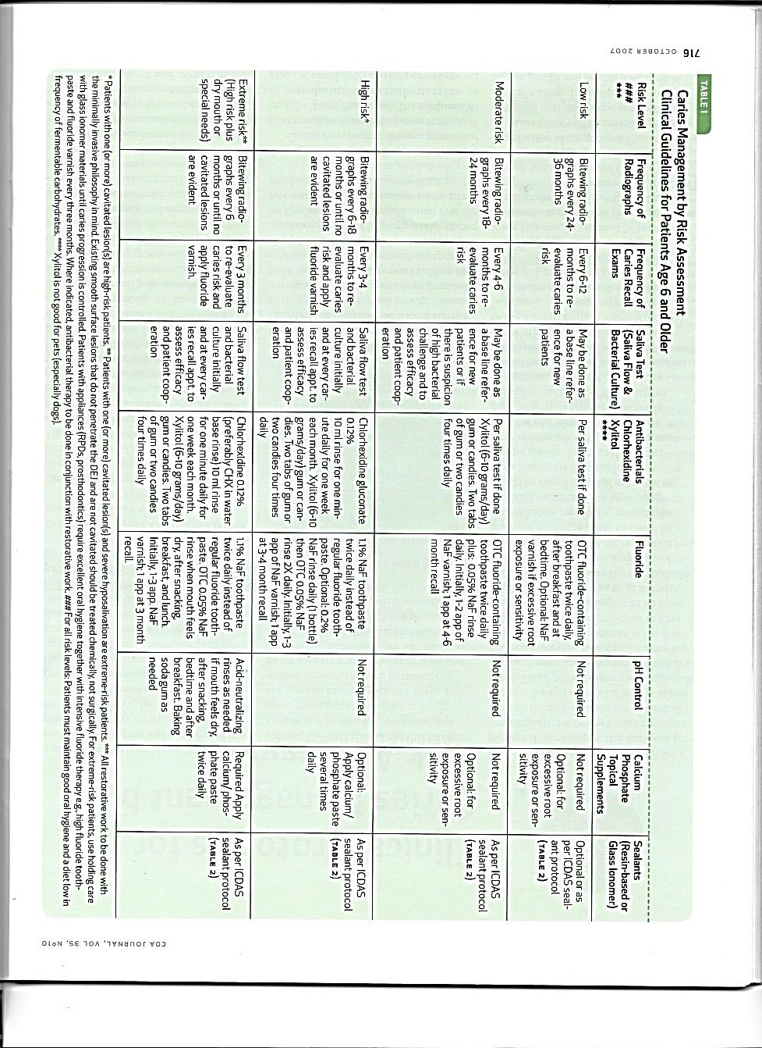

Slide 35

Simplifying CAMBRA (CRM)
“The current recommendation is to implement a risk assessment based medical model to diagnose and treat dental caries. Unfortunately, many of the suggestions of CAMBRA have been overly complicated and confusing for practitioners. The risk of caries, however, is usually related to just a few common factors and understanding these factors makes CAMBRA more clinically adaptable.”
Kutsch VK. Dental caries: An updated medical model of risk assessment. J Prosthet Dent 2014 April 11(4):280-5.

Slide 36

Diet
55%
Biofilm
46-51%
Genetics
9%
pH
100%
Saliva
63%
PATTERN RECOGNITION
Notes:
Abstract
Objective: The present review aimed to systematically evaluate the occurrence of caries in patients with inflammatory bowel disease (IBD), either Crohn's disease (CD) or ulcerative colitis (UC), compared to healthy controls.
Materials and methods: MEDLINE (PubMed), Embase, Google Scholar, LILACS, and Cochrane Library electronic databases were screened. Caries experience was measured through the Decayed, Missing, Filled Teeth (DMFT) index. The weighted mean difference (WMD) with 95% confidence interval was calculated between IBD patients and healthy controls.
Results: Six studies were selected for the inclusion in the systematic review, 5 of which were also included in the quantitative synthesis of data. The WMD in the DMFT index between IBD and healthy subjects was 3.04 (1.52, 4.56) (p = 0.10). Subgroup analysis showed no difference (p = 0.31) between CD (2.52 [0.54, 4.49]) and UC (4.01 [1.52, 4.56]) subjects.
Conclusions: There is a remarkably higher past and present occurrence of dental caries in subjects with IBD than healthy controls. This result should encourage clinicians to include oral health preventive programs in the overall treatment plan of IBD patients.
7

Slide 37
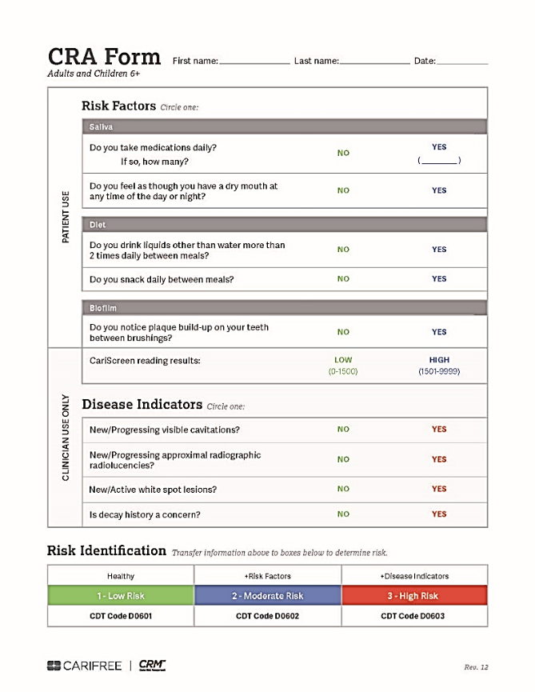


Caries Risk Assessment
Dr. John Kois

Slide 38
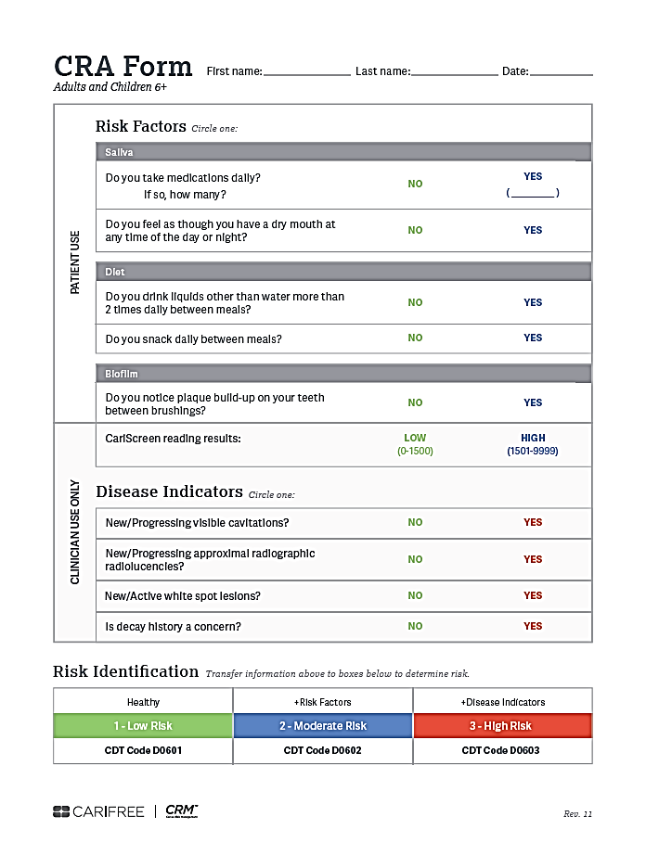
Caries Risk Assessment
D0601 Low Risk
D0602 Moderate Risk
D0603 High Risk

Slide 39
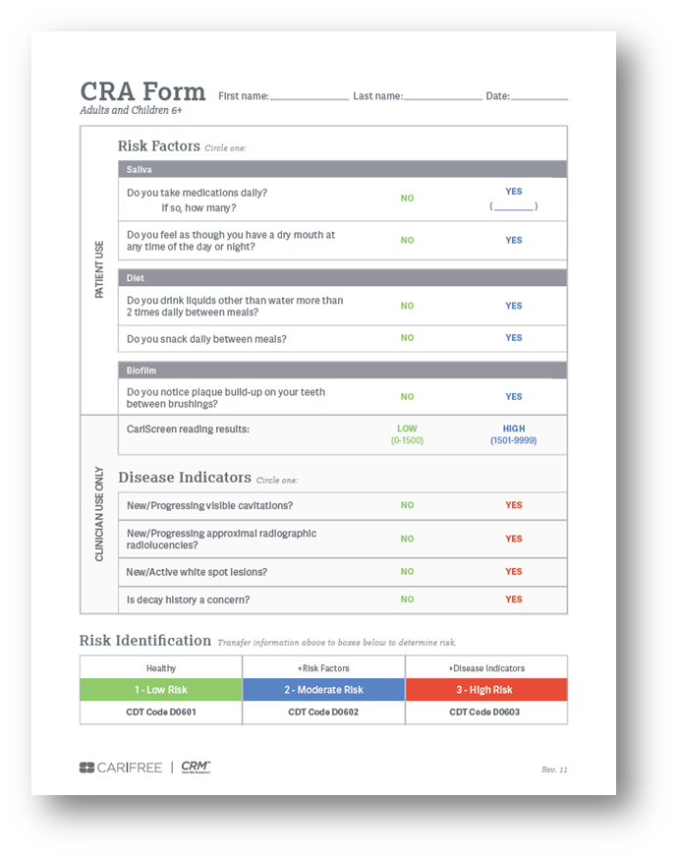
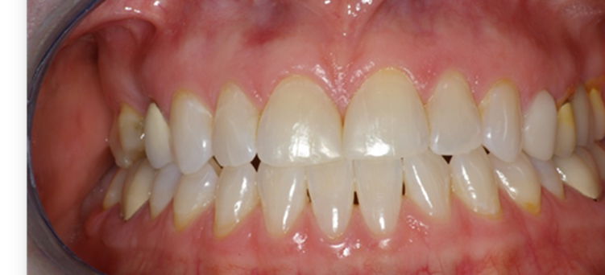
1. Do you take medications daily?
2. Do you have dry mouth?
pH
100%
PATTERN RECOGNITION
Notes:
Abstract
Objective: The present review aimed to systematically evaluate the occurrence of caries in patients with inflammatory bowel disease (IBD), either Crohn's disease (CD) or ulcerative colitis (UC), compared to healthy controls.
Materials and methods: MEDLINE (PubMed), Embase, Google Scholar, LILACS, and Cochrane Library electronic databases were screened. Caries experience was measured through the Decayed, Missing, Filled Teeth (DMFT) index. The weighted mean difference (WMD) with 95% confidence interval was calculated between IBD patients and healthy controls.
Results: Six studies were selected for the inclusion in the systematic review, 5 of which were also included in the quantitative synthesis of data. The WMD in the DMFT index between IBD and healthy subjects was 3.04 (1.52, 4.56) (p = 0.10). Subgroup analysis showed no difference (p = 0.31) between CD (2.52 [0.54, 4.49]) and UC (4.01 [1.52, 4.56]) subjects.
Conclusions: There is a remarkably higher past and present occurrence of dental caries in subjects with IBD than healthy controls. This result should encourage clinicians to include oral health preventive programs in the overall treatment plan of IBD patients.
10

Slide 40

SALIVA & Rx Meds
  70% Americans take one
50+% take two or more
20% take five or more
  6.3B prescriptions written for $359B (IQVIA Institute 2021)

Slide 41

Dry Mouth Raises Disease Risk
“After adjusting for confounding variables, participants with a flow rate ≤3.5 mL/min had significantly higher odds ratios for high caries status…The present findings suggest that decreased saliva secretion affects both dental caries and general periodontal health status.”
Shimazaki Y, Fu B, Yonemoto K, Akifusa S, Shibata Y, et al. Stimulated salivary flow rate and oral health status. J Oral Sci. 2016 Dec 28. 2110 Japan Ad >10 teeth

Slide 42
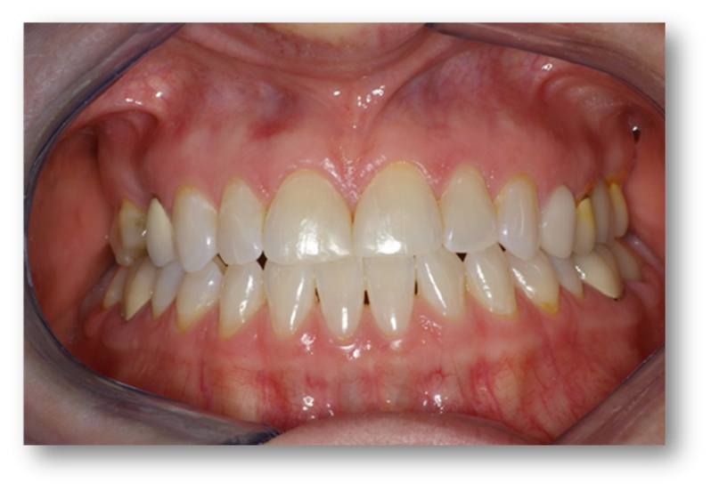
1. Lack of saliva / dry tissue
2. Medications
PATTERN RECOGNITION
Notes:
Abstract
Objective: The present review aimed to systematically evaluate the occurrence of caries in patients with inflammatory bowel disease (IBD), either Crohn's disease (CD) or ulcerative colitis (UC), compared to healthy controls.
Materials and methods: MEDLINE (PubMed), Embase, Google Scholar, LILACS, and Cochrane Library electronic databases were screened. Caries experience was measured through the Decayed, Missing, Filled Teeth (DMFT) index. The weighted mean difference (WMD) with 95% confidence interval was calculated between IBD patients and healthy controls.
Results: Six studies were selected for the inclusion in the systematic review, 5 of which were also included in the quantitative synthesis of data. The WMD in the DMFT index between IBD and healthy subjects was 3.04 (1.52, 4.56) (p = 0.10). Subgroup analysis showed no difference (p = 0.31) between CD (2.52 [0.54, 4.49]) and UC (4.01 [1.52, 4.56]) subjects.
Conclusions: There is a remarkably higher past and present occurrence of dental caries in subjects with IBD than healthy controls. This result should encourage clinicians to include oral health preventive programs in the overall treatment plan of IBD patients.
13

Slide 43
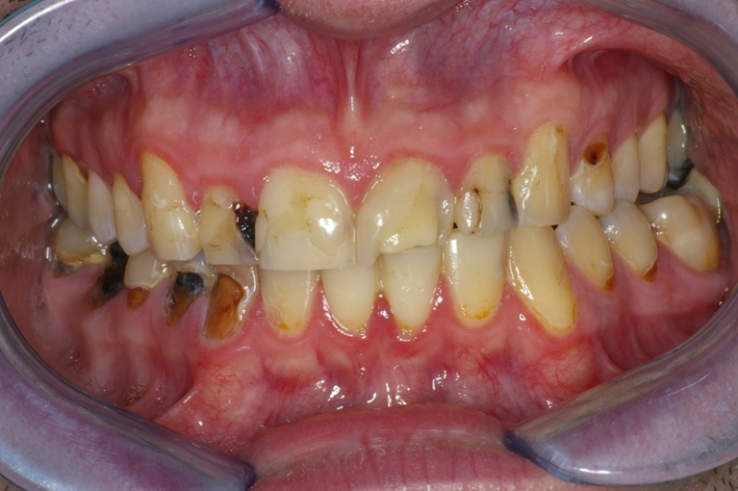
Do you drink liquids, other than water, more than 2 times per day, between meals?
Diet
55%
pH
100%
Saliva
63%
PATTERN RECOGNITION
Notes:
Abstract
Objective: The present review aimed to systematically evaluate the occurrence of caries in patients with inflammatory bowel disease (IBD), either Crohn's disease (CD) or ulcerative colitis (UC), compared to healthy controls.
Materials and methods: MEDLINE (PubMed), Embase, Google Scholar, LILACS, and Cochrane Library electronic databases were screened. Caries experience was measured through the Decayed, Missing, Filled Teeth (DMFT) index. The weighted mean difference (WMD) with 95% confidence interval was calculated between IBD patients and healthy controls.
Results: Six studies were selected for the inclusion in the systematic review, 5 of which were also included in the quantitative synthesis of data. The WMD in the DMFT index between IBD and healthy subjects was 3.04 (1.52, 4.56) (p = 0.10). Subgroup analysis showed no difference (p = 0.31) between CD (2.52 [0.54, 4.49]) and UC (4.01 [1.52, 4.56]) subjects.
Conclusions: There is a remarkably higher past and present occurrence of dental caries in subjects with IBD than healthy controls. This result should encourage clinicians to include oral health preventive programs in the overall treatment plan of IBD patients.
14

Slide 44

DIET
  Americans eat 22.7tsp of sugar per day
  HFCS Americans #1 at 51 lbs. per year

Slide 45

1 in 4 Oral Diseases Linked to Sugar
“Overall, 26.3% (95% UI: 13.3% to 47.5%) of the total global oral disease burden was attributed to the consumption of free sugars (mono- and disaccharides MDS). The present study emphasizes the need to further address the role of free sugars in oral health and nutrition policy.”
Meier T, Deumelandt P, Christen O, Stangl GI, Riedel K, et al. Global Burden of Sugar-Related Dental Diseases in 168 Countries and Corresponding Health Care Costs. J Dent Res. 2017 Jul;96(8):845-854.

Slide 46
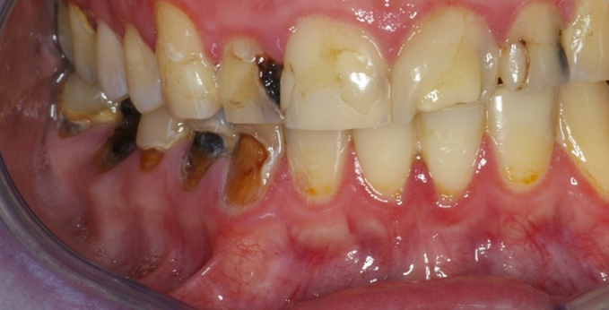
  1. Carious lesions distributed
PATTERN RECOGNITION
Notes:
Abstract
Objective: The present review aimed to systematically evaluate the occurrence of caries in patients with inflammatory bowel disease (IBD), either Crohn's disease (CD) or ulcerative colitis (UC), compared to healthy controls.
Materials and methods: MEDLINE (PubMed), Embase, Google Scholar, LILACS, and Cochrane Library electronic databases were screened. Caries experience was measured through the Decayed, Missing, Filled Teeth (DMFT) index. The weighted mean difference (WMD) with 95% confidence interval was calculated between IBD patients and healthy controls.
Results: Six studies were selected for the inclusion in the systematic review, 5 of which were also included in the quantitative synthesis of data. The WMD in the DMFT index between IBD and healthy subjects was 3.04 (1.52, 4.56) (p = 0.10). Subgroup analysis showed no difference (p = 0.31) between CD (2.52 [0.54, 4.49]) and UC (4.01 [1.52, 4.56]) subjects.
Conclusions: There is a remarkably higher past and present occurrence of dental caries in subjects with IBD than healthy controls. This result should encourage clinicians to include oral health preventive programs in the overall treatment plan of IBD patients.
17

Slide 47
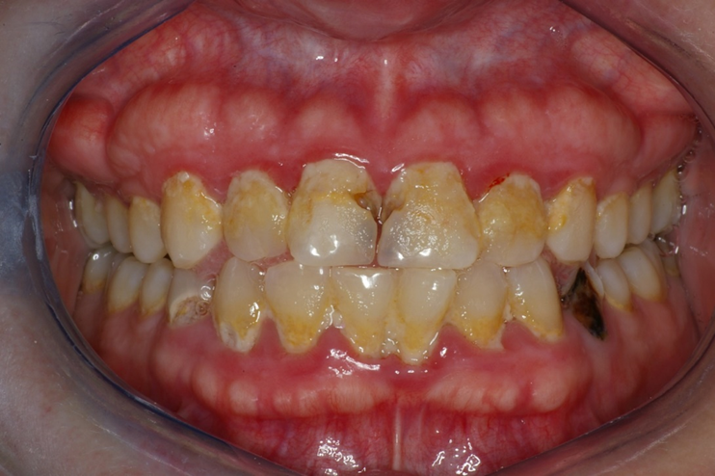
Do you notice plaque build up between
brushing your teeth?
pH
100%
PATTERN RECOGNITION
Notes:
Abstract
Objective: The present review aimed to systematically evaluate the occurrence of caries in patients with inflammatory bowel disease (IBD), either Crohn's disease (CD) or ulcerative colitis (UC), compared to healthy controls.
Materials and methods: MEDLINE (PubMed), Embase, Google Scholar, LILACS, and Cochrane Library electronic databases were screened. Caries experience was measured through the Decayed, Missing, Filled Teeth (DMFT) index. The weighted mean difference (WMD) with 95% confidence interval was calculated between IBD patients and healthy controls.
Results: Six studies were selected for the inclusion in the systematic review, 5 of which were also included in the quantitative synthesis of data. The WMD in the DMFT index between IBD and healthy subjects was 3.04 (1.52, 4.56) (p = 0.10). Subgroup analysis showed no difference (p = 0.31) between CD (2.52 [0.54, 4.49]) and UC (4.01 [1.52, 4.56]) subjects.
Conclusions: There is a remarkably higher past and present occurrence of dental caries in subjects with IBD than healthy controls. This result should encourage clinicians to include oral health preventive programs in the overall treatment plan of IBD patients.
18

Slide 48
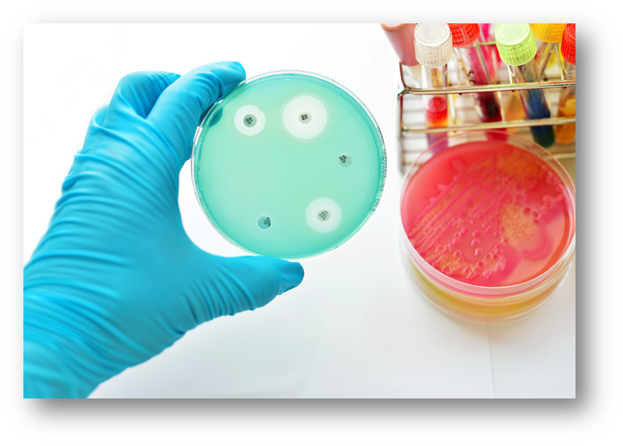
BIOFILM
  Over 60 microbes now identified as potential cariogens
  Cariogenic microbiome
  Most recent Candida spp. albicans, dubliniensis, parapsilosis

Slide 49

Poor Hygiene + Bacteria = More Decay
“The mean cumulative DMFS demonstrated Higher salivary MS and LB counts, low tooth brushing frequency and daily soft drink consumption were significantly related to greater caries experience…caries experience in those with higher counts of MS and LB were 51 and 52% more than those with lower counts.”
Lalloo R, Tadakamadla SK, Kroon J, et al. Salivary characteristics and dental caries experience in remote Indigenous children in Australia: a cross-sectional study. BMC Oral Health. 2019;19(1):21.
Notes:
Abstract
Background: While associations between salivary characteristics and dental caries have been well studied, we are not aware of this being assessed in a remote Indigenous child population, where lifestyles may be different from urban children. Our aim was to assess associations between caries experience and putative biomarkers in saliva, accounting for oral hygiene and dietary habits.
Methods: Children attending schools in an Indigenous community in remote north Queensland, Australia were invited to an oral examination by qualified and calibrated examiners. Salivary flow rate, pH, buffering capacity and loads of mutans streptococci (MS), lactobacilli (LB) and yeasts were determined. Also, data on tooth brushing frequency and soft drinks consumption were obtained via a questionnaire. Caries experience was recorded by the International Caries Detection and Assessment System (ICDAS-II), and quantified as decayed, missing and filled surfaces. Relationships between the salivary variables and the cumulative caries experience (dmfs+DMFS) in the deciduous and permanent dentitions were examined by multivariate analyses to control the effect of confounders.
Results: The mean cumulative decayed (DS + ds), missing (MS + ms) and filled (FS + fs) surfaces were 3.64 (SD: 4.97), 1.08 (4.38) and 0.79 (1.84) respectively. Higher salivary MS and LB counts, low tooth brushing frequency and daily soft drink consumption were significantly related to greater caries experience. Caries experience was about twice in those with ≥10^5 CFU/ml saliva counts of MS (mean = 6.33, SD: 8.40 vs 3.11, 5.77) and LB (7.03, 7.49 vs 4.41, 8.00). In the fully-adjusted multivariate model, caries experience in those with higher counts of MS and LB were 51 and 52% more than those with lower counts.
Conclusions: As with studies in other populations, childhood salivary counts of MS and LB were significantly associated with greater caries experience in this remote Indigenous community. To address the serious burden of oral disease, we are researching ways to promote a healthy oral environment by encouraging good dietary habits, and emphasising the importance of daily tooth brushing with a fluoridated toothpaste. Our ongoing longitudinal studies will indicate the success of measures employed to reduce the counts of bacteria closely associated with cariogenesis and their impact on caries increment.
20

Slide 50
  1. Visible plaque
  2. High Cariscreen
Diet
55%
PATTERN RECOGNITION
Notes:
Abstract
Objective: The present review aimed to systematically evaluate the occurrence of caries in patients with inflammatory bowel disease (IBD), either Crohn's disease (CD) or ulcerative colitis (UC), compared to healthy controls.
Materials and methods: MEDLINE (PubMed), Embase, Google Scholar, LILACS, and Cochrane Library electronic databases were screened. Caries experience was measured through the Decayed, Missing, Filled Teeth (DMFT) index. The weighted mean difference (WMD) with 95% confidence interval was calculated between IBD patients and healthy controls.
Results: Six studies were selected for the inclusion in the systematic review, 5 of which were also included in the quantitative synthesis of data. The WMD in the DMFT index between IBD and healthy subjects was 3.04 (1.52, 4.56) (p = 0.10). Subgroup analysis showed no difference (p = 0.31) between CD (2.52 [0.54, 4.49]) and UC (4.01 [1.52, 4.56]) subjects.
Conclusions: There is a remarkably higher past and present occurrence of dental caries in subjects with IBD than healthy controls. This result should encourage clinicians to include oral health preventive programs in the overall treatment plan of IBD patients.
21

Slide 51
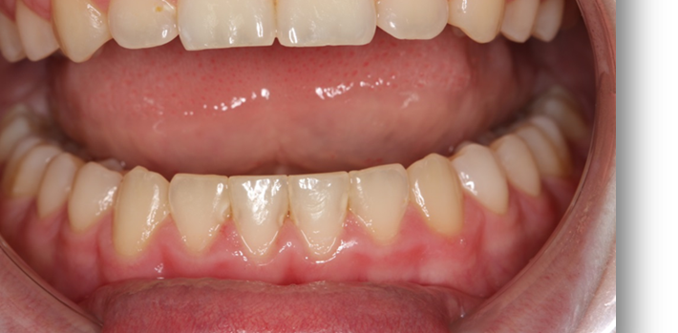
?
pH
100%
PATTERN RECOGNITION
Notes:
Abstract
Objective: The present review aimed to systematically evaluate the occurrence of caries in patients with inflammatory bowel disease (IBD), either Crohn's disease (CD) or ulcerative colitis (UC), compared to healthy controls.
Materials and methods: MEDLINE (PubMed), Embase, Google Scholar, LILACS, and Cochrane Library electronic databases were screened. Caries experience was measured through the Decayed, Missing, Filled Teeth (DMFT) index. The weighted mean difference (WMD) with 95% confidence interval was calculated between IBD patients and healthy controls.
Results: Six studies were selected for the inclusion in the systematic review, 5 of which were also included in the quantitative synthesis of data. The WMD in the DMFT index between IBD and healthy subjects was 3.04 (1.52, 4.56) (p = 0.10). Subgroup analysis showed no difference (p = 0.31) between CD (2.52 [0.54, 4.49]) and UC (4.01 [1.52, 4.56]) subjects.
Conclusions: There is a remarkably higher past and present occurrence of dental caries in subjects with IBD than healthy controls. This result should encourage clinicians to include oral health preventive programs in the overall treatment plan of IBD patients.
22

Slide 52
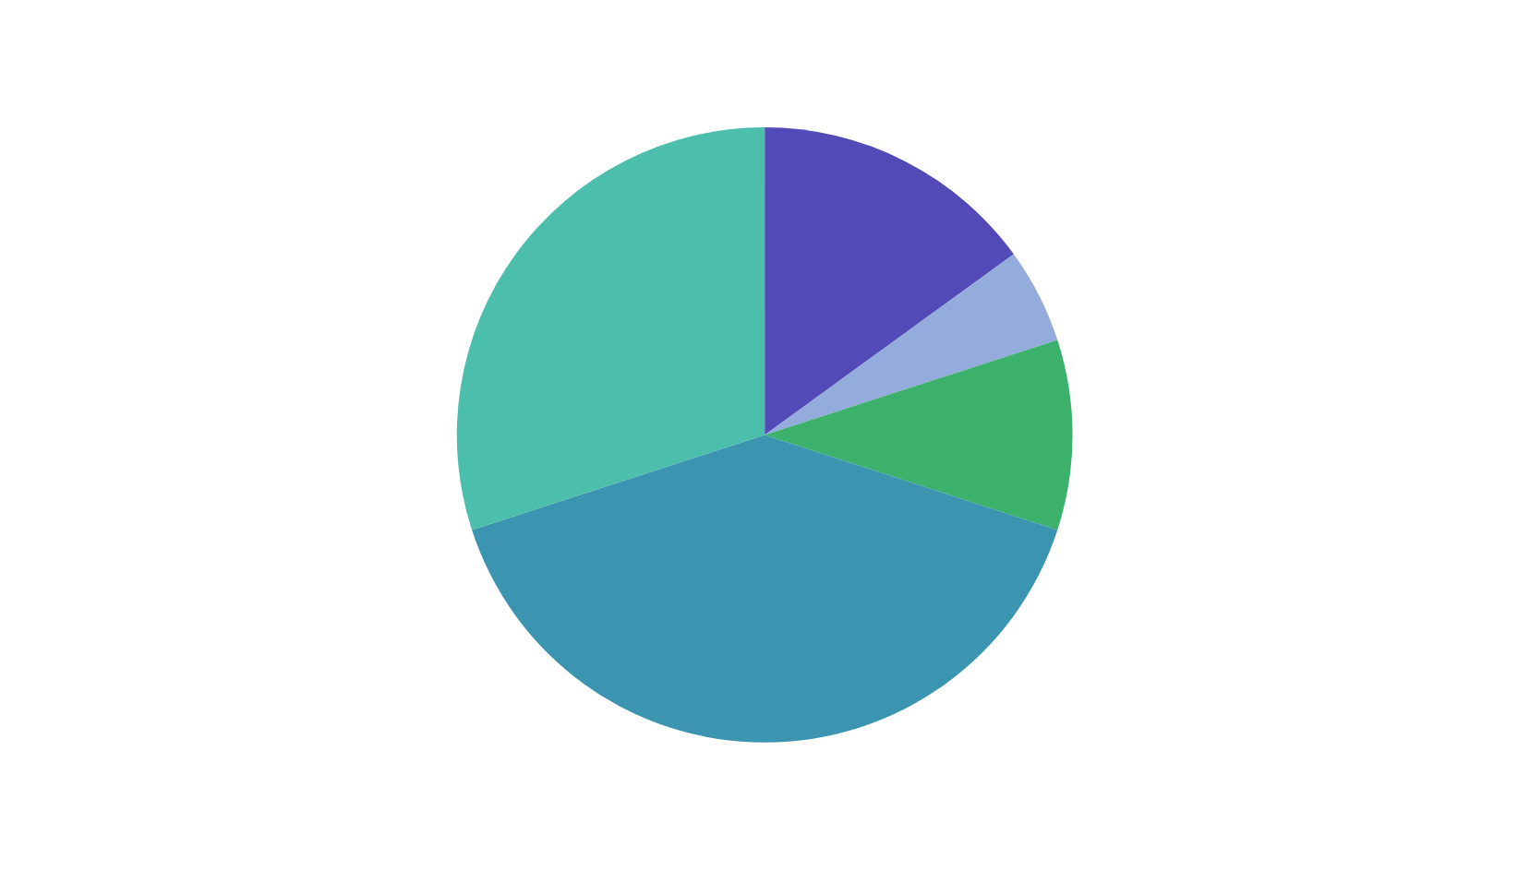
GENETICS
Social Circumstances
15%
Genetic
Predisposition
30%
Environmental
Exposure 5%
Health
Care 10%
Boynes SG, Novy BB, Peltier C. Risk based treatment planning. Decisions in Dentistry February 2017. 3(2):53-57.
Behavioral
Patterns 40%

Slide 53
Diet
55%
Biofilm
46-51%
Genetics
9%
pH
100%
Saliva
63%
PATTERN RECOGNITION
Notes:
Abstract
Objective: The present review aimed to systematically evaluate the occurrence of caries in patients with inflammatory bowel disease (IBD), either Crohn's disease (CD) or ulcerative colitis (UC), compared to healthy controls.
Materials and methods: MEDLINE (PubMed), Embase, Google Scholar, LILACS, and Cochrane Library electronic databases were screened. Caries experience was measured through the Decayed, Missing, Filled Teeth (DMFT) index. The weighted mean difference (WMD) with 95% confidence interval was calculated between IBD patients and healthy controls.
Results: Six studies were selected for the inclusion in the systematic review, 5 of which were also included in the quantitative synthesis of data. The WMD in the DMFT index between IBD and healthy subjects was 3.04 (1.52, 4.56) (p = 0.10). Subgroup analysis showed no difference (p = 0.31) between CD (2.52 [0.54, 4.49]) and UC (4.01 [1.52, 4.56]) subjects.
Conclusions: There is a remarkably higher past and present occurrence of dental caries in subjects with IBD than healthy controls. This result should encourage clinicians to include oral health preventive programs in the overall treatment plan of IBD patients.
24

Slide 54

Diet
55%
Biofilm
46-51%
Genetics
9%
pH
100%
Saliva
63%
PATTERN RECOGNITION
Notes:
Abstract
Objective: The present review aimed to systematically evaluate the occurrence of caries in patients with inflammatory bowel disease (IBD), either Crohn's disease (CD) or ulcerative colitis (UC), compared to healthy controls.
Materials and methods: MEDLINE (PubMed), Embase, Google Scholar, LILACS, and Cochrane Library electronic databases were screened. Caries experience was measured through the Decayed, Missing, Filled Teeth (DMFT) index. The weighted mean difference (WMD) with 95% confidence interval was calculated between IBD patients and healthy controls.
Results: Six studies were selected for the inclusion in the systematic review, 5 of which were also included in the quantitative synthesis of data. The WMD in the DMFT index between IBD and healthy subjects was 3.04 (1.52, 4.56) (p = 0.10). Subgroup analysis showed no difference (p = 0.31) between CD (2.52 [0.54, 4.49]) and UC (4.01 [1.52, 4.56]) subjects.
Conclusions: There is a remarkably higher past and present occurrence of dental caries in subjects with IBD than healthy controls. This result should encourage clinicians to include oral health preventive programs in the overall treatment plan of IBD patients.
25

Slide 55

Summary: Rethink Dental Caries
Focus on the cause. WHY?
A biofilm dysbiosis with known risk factors.
Has systemic and genetic components
Use a validated risk assessment form
Learn pattern recognition
Notes:
Dental caries is an endogenous microbial community-based
disease resulting from an ecological shift from dynamic stability to metabolic imbalance in a consortium of acidogenic
and aciduric bacteria comprising the dental plaque biofilm.
Participants were members of the Dunedin Multidisciplinary
Health and Development Study, a longitudinal investigation
of health and behaviour in a cohort born in Dunedin, New
Zealand. Oral biofilm samples (collected at age 32 years)
from anterior labial supragingival, posterior lingual supragingival, posterior subgingival, and the dorsum of the tongue
habitats for 841 participants were analysed using checkerboard DNA-DNA hybridisation (CKB), focussing on 30 ecologically significant bacteria. Associations of CKB data with
dental caries at ages 32 and 45 years were assessed using
regression modelling, adjusting for potential confounders
including sex, xerostomia, and oral hygiene. The putative
periodontitis pathobiont Tannerella forsythia (in the anterior
supragingival biofilm) was associated with untreated caries
at age 32 years. The percentage of total summed cell number
counts for two putative periodontitis-associated species (T.
forsythia and Micromonas micros) was associated with greater caries experience at age 32 years and the development of
new caries between age 32 and 45 years. Additionally, severe
caries (3 + cavities) was associated with putative caries
pathobionts (Lactobacillus fermentum, Lactobacillus plantarum), periodontitis-associated species, and commensals
(M. micros, Campylobacter rectus, Streptococcus mitis biovar I,
Streptococcus mitis biovar II) in the subgingival biofilm. Participants with sustained poor oral hygiene through age 32
years not only had greater experience of caries by that age
than those with good oral hygiene (fully adjusted incidence
risk ratio = 5.10, 95% CI: 3.30, 7.89) but also experienced
greater incidence of new caries from age 32 to 45 years (incidence risk ratio = 3.69, 95% CI: 2.62, 5.20). These findings
provide evidence in support of the extended caries ecological plaque hypotheses, the polymicrobial aetiology of caries,
and the integrated aetiology of dental caries and periodontal diseases. They also underscore the roles of poor oral selfcare (particularly over the life course) and xerostomia in the
occurrence and progression of caries. ©

Slide 56
Thank you!
kimkutsch@aol.com

Slide 57



Join us for Part 2
for another special offer!
Enjoy 15% off
our Nano-HA Gels*
Use code BLATCHFORD15
Not ready to order?
Scan for FREE samples
*One time use. Cannot be combined with other discounts.
Valid until 10.6.26
carifreepro.com

