Slide 1

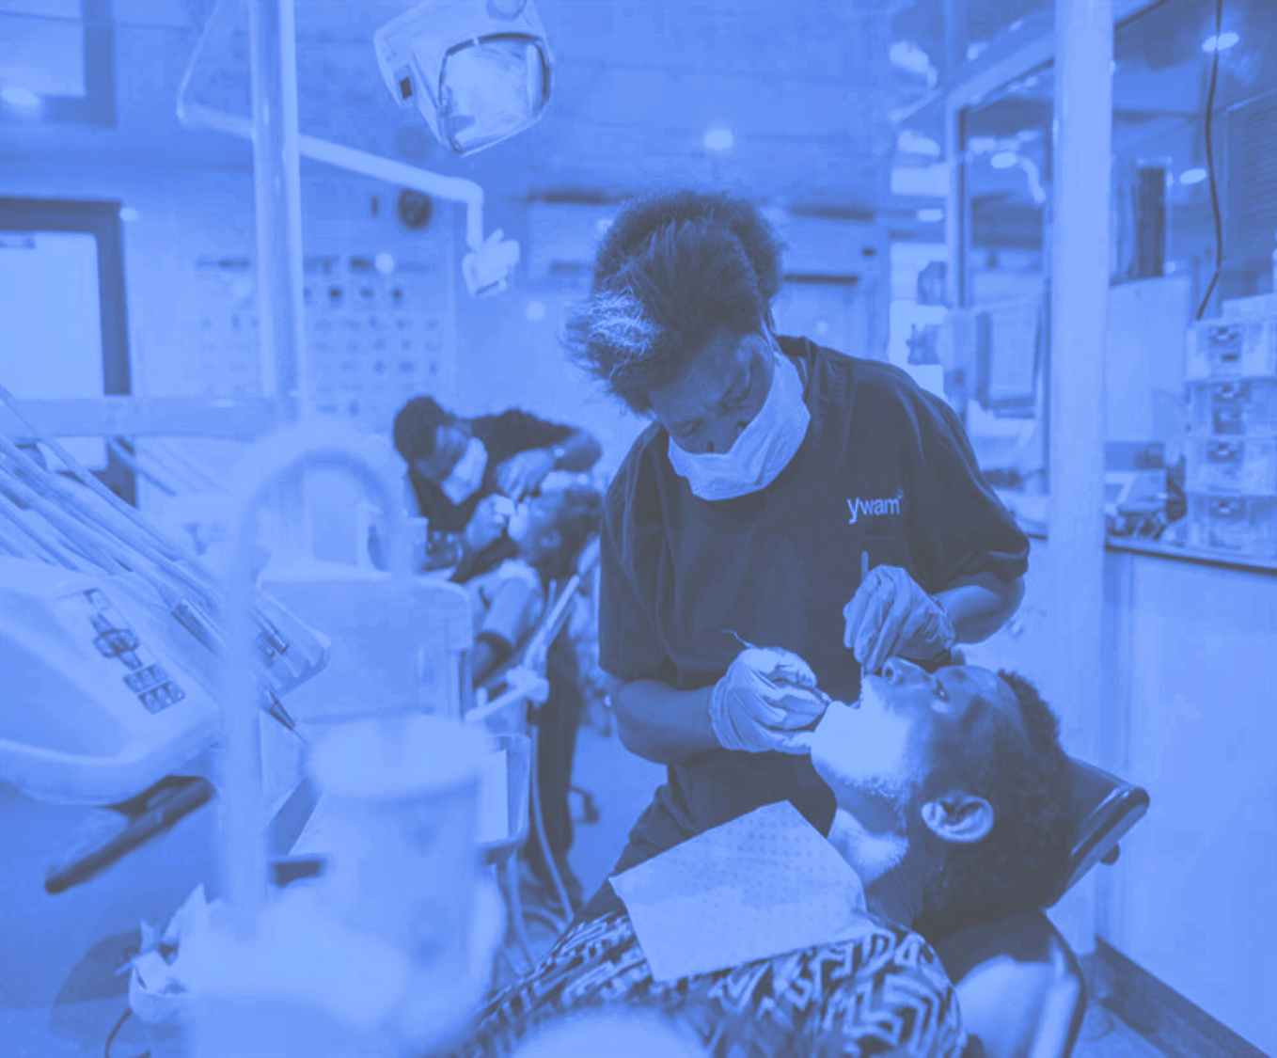
Dental Caries Part 2:
From Risk to Action
Monitor, Remineralize or Restore?
V. Kim Kutsch, DMD

Slide 2
Risk Assessment
Diagnosis
Treatment
CRA
Diagnosis
Prescribe

Slide 3

P4 MEDICINE
Leroy Hood, MD 2010
0
“Combining technology, biology and a wellness approach, medicine is capable of providing care on a molecular, cellular and organ level to personalize each individual’s unique health experience. This information will make medical care radically more cost effective by personalizing care to each person’s unique biology and by treating the causes rather than the symptoms of disease.”

Slide 4
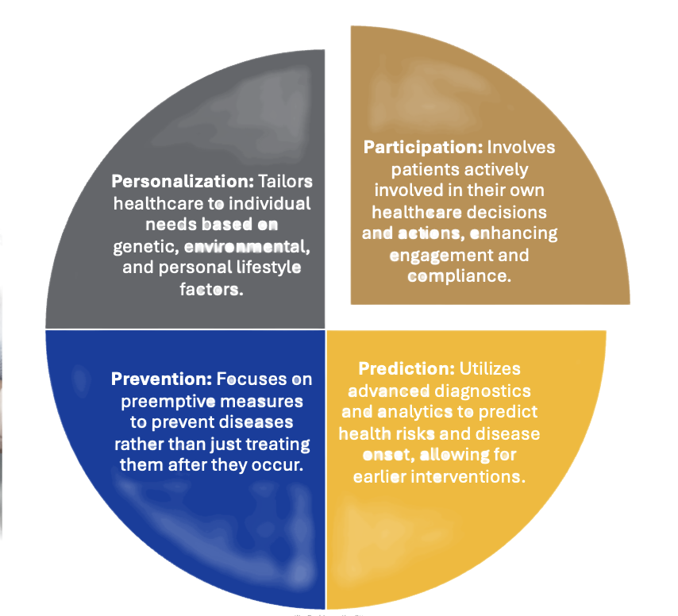
P4 Dentistry/Caries Risk Management (CRM)
Predictive
Preventive
Personalized
Participatory

Slide 5
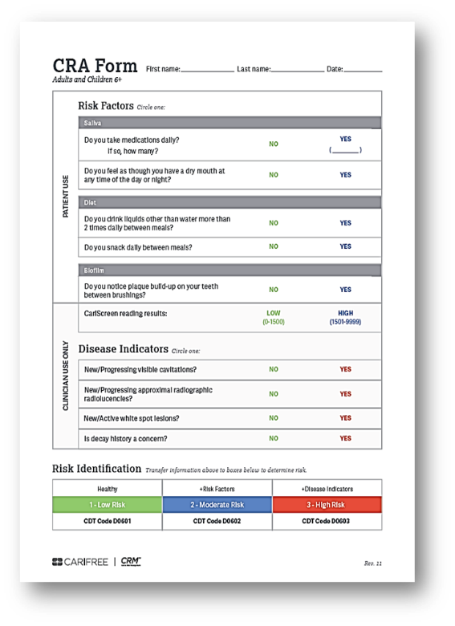
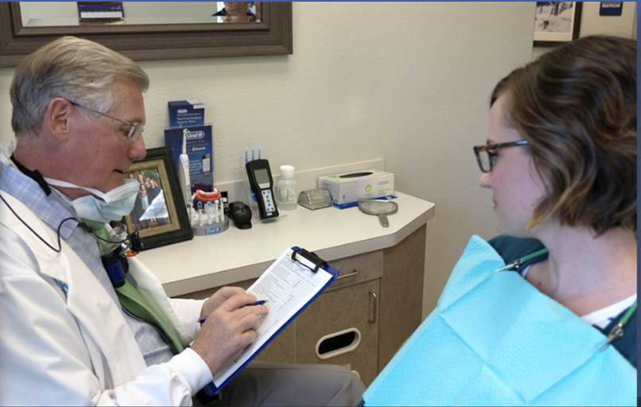

1 – Caries Risk Assessment (CRA)
Notes:
Abstract
Objective: The present review aimed to systematically evaluate the occurrence of caries in patients with inflammatory bowel disease (IBD), either Crohn's disease (CD) or ulcerative colitis (UC), compared to healthy controls.
Materials and methods: MEDLINE (PubMed), Embase, Google Scholar, LILACS, and Cochrane Library electronic databases were screened. Caries experience was measured through the Decayed, Missing, Filled Teeth (DMFT) index. The weighted mean difference (WMD) with 95% confidence interval was calculated between IBD patients and healthy controls.
Results: Six studies were selected for the inclusion in the systematic review, 5 of which were also included in the quantitative synthesis of data. The WMD in the DMFT index between IBD and healthy subjects was 3.04 (1.52, 4.56) (p = 0.10). Subgroup analysis showed no difference (p = 0.31) between CD (2.52 [0.54, 4.49]) and UC (4.01 [1.52, 4.56]) subjects.
Conclusions: There is a remarkably higher past and present occurrence of dental caries in subjects with IBD than healthy controls. This result should encourage clinicians to include oral health preventive programs in the overall treatment plan of IBD patients.

Slide 6

Risk Today Predicts Decay Tomorrow
“These results lend evidence that baseline caries risk predicts future caries in this setting, supporting the use of caries risk assessment to identify candidate patients for more intensive preventive therapy.”
Chaffee BW, Cheng J, Featherstone JD. Baseline caries risk assessment as a predictor of caries incidence. J Dent. 2015 May;43(5):518-24.

Slide 7

Spaced Prevention Works
“However, repeated, spaced delivery of anti-caries agents was associated with approximately one decayed or restored tooth prevented over 18 months for every three patients treated.”
Chaffee BW, Cheng J, Featherstone JD. Non-operative anti-caries agents and dental caries increment among adults at high caries risk: a retrospective cohort study.BMC Oral Health. 2015 Sep 24;15(1):111. 2724 Ad, 18 mos, 1 DMFT/3

Slide 8

Additive Effects
“These findings suggest a greater intervention effect carried through the combined action on multiple aspects of the caries process rather than through any single factor.”
CRM
Cheng J, Chaffee BW, Cheng NF, Gansky SA, Featherstone JDB. Understanding Treatment Effect Mechanisms of the CAMBRA Randomized Trial in Reducing Caries Increment. J Dent Res. 2014 Oct 29. 109, 1-7, 24mosDMFT

Slide 9

Substantivity
“The overall 4-year post-trial result (years 4-7) for CMS patients was a DMFT increment of 2.44 compared with 3.39 for control patients, a difference equivalent to 28%.”
Evans RW, Clark P, Jia N. The Caries Management System: are preventive effects sustained post clinical trial? Community Dent Oral Epidemiol. 2015 Dec 7.19 Practices

Slide 10
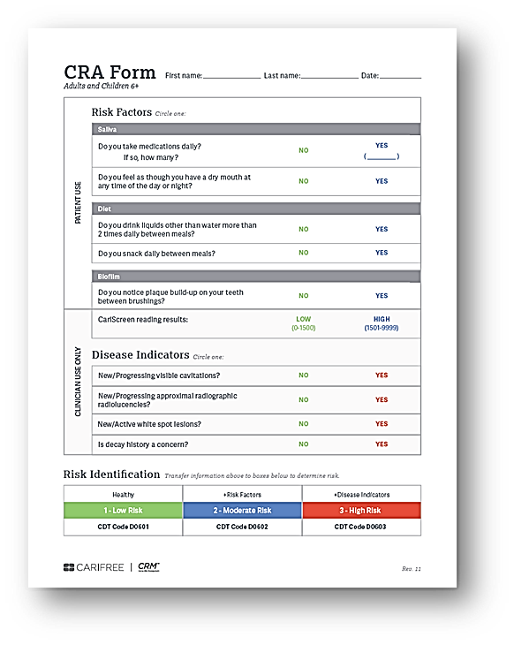
Halasa-Rappel YA, Ng MW, Gaumer G, Banks DA.How useful are current caries risk assessment tools in informing the oral health care decision-making process? J Am Dent Assoc. 2019 Feb;150(2):91-102. 10 CRA models, 1-20 yo.
Caries Risk Models Lack Consistency
“The authors found substantial variation among the selected models in assigning risk levels. The weighted average proportions (range) of people categorized as at low, moderate, and high risk were 25% (0%-66%), 14% (0%-50%), and 61% (11%-100%), respectively…”
Notes:
Abstract
Background: Dental caries risk factors have been expanded to not only emphasize biology, dietary and oral habits but also broader social determinants such as socioeconomic factors and the utilization of health services. The aim was to review sociobehavioural/cultural and socioeconomic determinants of dental caries in children residing in the Middle East and North Africa (MENA) region.
Methods: A search was conducted in the PubMed/Medline database and Google Scholar to identify studies published from 2000 to 2019 covering children using key search terms. In the initial stages, titles, abstracts and, if needed, full articles were screened for eligibility. In the final stage, all included articles were reassessed and read, and relevant data were extracted.
Results: Out of 600 initial articles, a total of 77 were included in this review, of which 74 were cross-sectional, 2 were longitudinal and one was a case-control study. The studies included a total of 94,491 participants in 14 countries across the MENA region. A majority used the World Health Organization scoring system to assess dental caries. The caries prevalence ranged between 17.2% and 88.8%, early childhood caries between 3% and 57% and decayed missing filled teeth (dmft) varied between 0.6 and 8.5 across the various age groups. Increased age, low maternal education, low overall socioeconomic status, decreased frequency of tooth brushing, low parental involvement, poor oral habits, infant feeding practices and sugar consumption were among the most prevalent determinants for increased risk of caries in the reviewed studies.
Conclusions: Dental caries was found to be high among children in many of the studies published from MENA. The key determinants of dental caries were found to include factors related to child characteristics, family background, oral hygiene and infant feeding and eating habits. The high dental caries prevalence emphasises the need to address the prevailing modifiable sociobehavioural and socioeconomic determinants by translating them into effective oral health prevention policies and programmes.

Slide 11
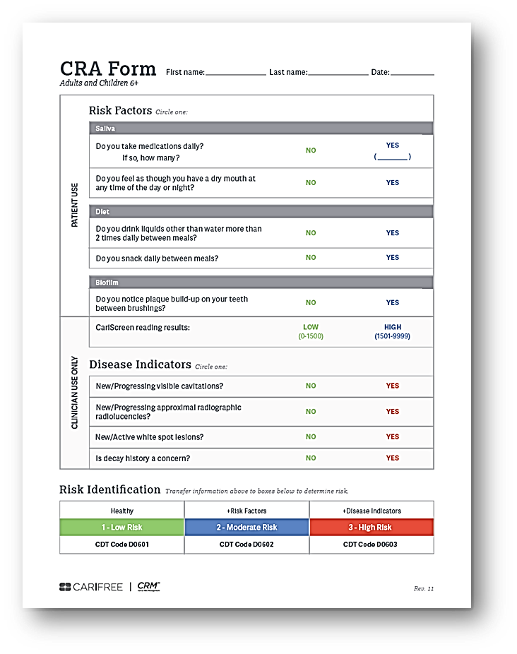
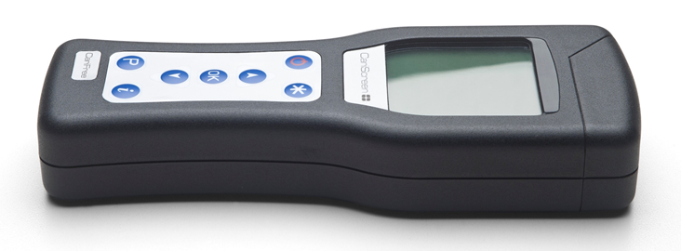
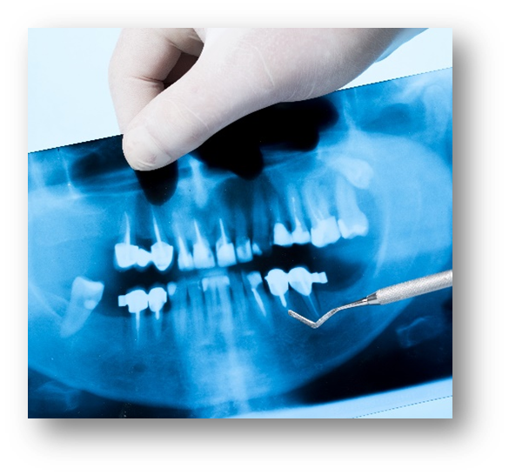
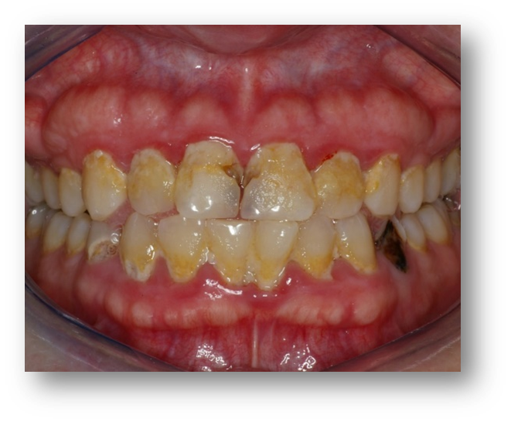
2. Caries Diagnosis
Notes:
Abstract
Objective: The present review aimed to systematically evaluate the occurrence of caries in patients with inflammatory bowel disease (IBD), either Crohn's disease (CD) or ulcerative colitis (UC), compared to healthy controls.
Materials and methods: MEDLINE (PubMed), Embase, Google Scholar, LILACS, and Cochrane Library electronic databases were screened. Caries experience was measured through the Decayed, Missing, Filled Teeth (DMFT) index. The weighted mean difference (WMD) with 95% confidence interval was calculated between IBD patients and healthy controls.
Results: Six studies were selected for the inclusion in the systematic review, 5 of which were also included in the quantitative synthesis of data. The WMD in the DMFT index between IBD and healthy subjects was 3.04 (1.52, 4.56) (p = 0.10). Subgroup analysis showed no difference (p = 0.31) between CD (2.52 [0.54, 4.49]) and UC (4.01 [1.52, 4.56]) subjects.
Conclusions: There is a remarkably higher past and present occurrence of dental caries in subjects with IBD than healthy controls. This result should encourage clinicians to include oral health preventive programs in the overall treatment plan of IBD patients.

Slide 12
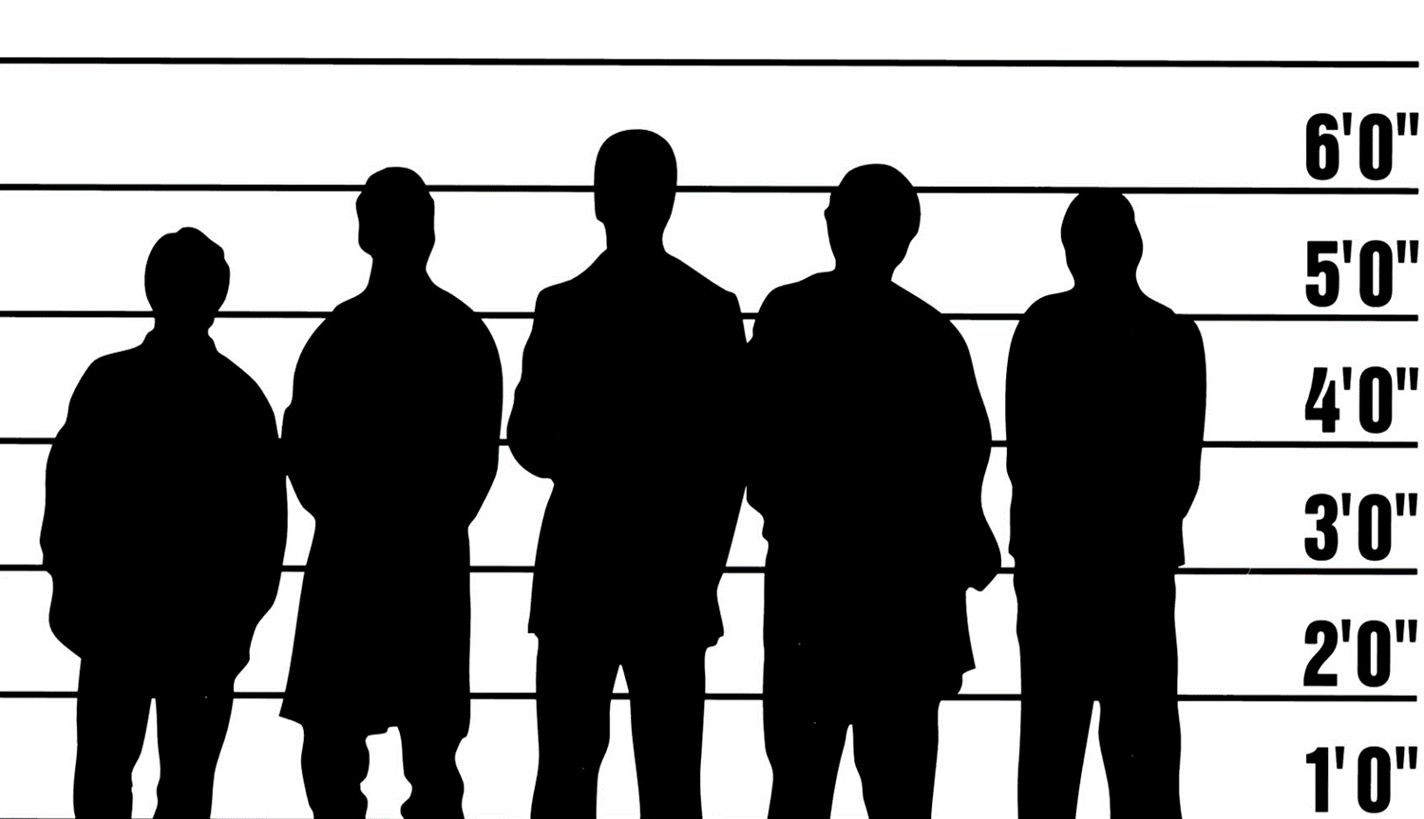
Diet
55%
Biofilm
46-51%
Genetics
9%
pH
100%
Saliva
63%
PATTERN RECOGNITION
Notes:
Abstract
Objective: The present review aimed to systematically evaluate the occurrence of caries in patients with inflammatory bowel disease (IBD), either Crohn's disease (CD) or ulcerative colitis (UC), compared to healthy controls.
Materials and methods: MEDLINE (PubMed), Embase, Google Scholar, LILACS, and Cochrane Library electronic databases were screened. Caries experience was measured through the Decayed, Missing, Filled Teeth (DMFT) index. The weighted mean difference (WMD) with 95% confidence interval was calculated between IBD patients and healthy controls.
Results: Six studies were selected for the inclusion in the systematic review, 5 of which were also included in the quantitative synthesis of data. The WMD in the DMFT index between IBD and healthy subjects was 3.04 (1.52, 4.56) (p = 0.10). Subgroup analysis showed no difference (p = 0.31) between CD (2.52 [0.54, 4.49]) and UC (4.01 [1.52, 4.56]) subjects.
Conclusions: There is a remarkably higher past and present occurrence of dental caries in subjects with IBD than healthy controls. This result should encourage clinicians to include oral health preventive programs in the overall treatment plan of IBD patients.
7

Slide 13
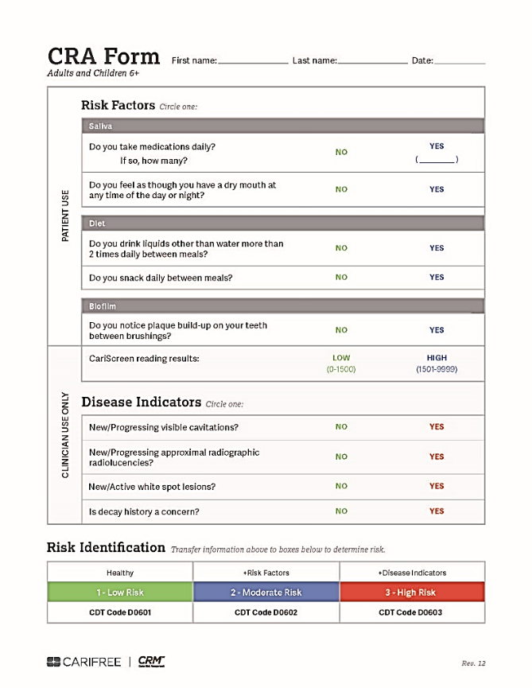
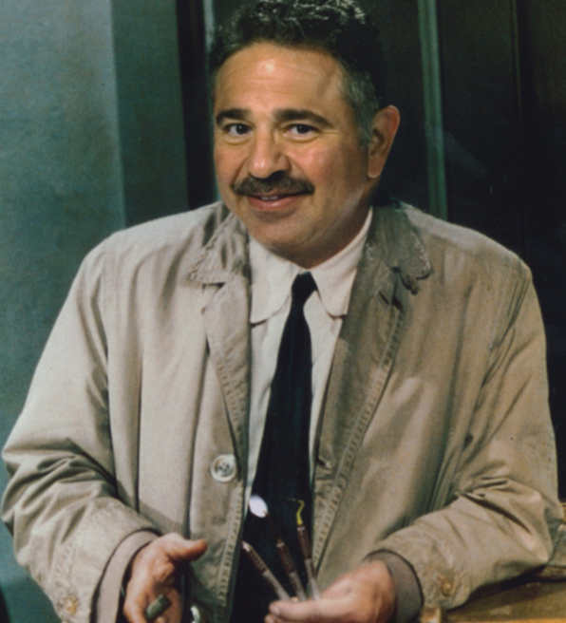
Caries Risk Assessment
Dr. John Kois

Slide 14
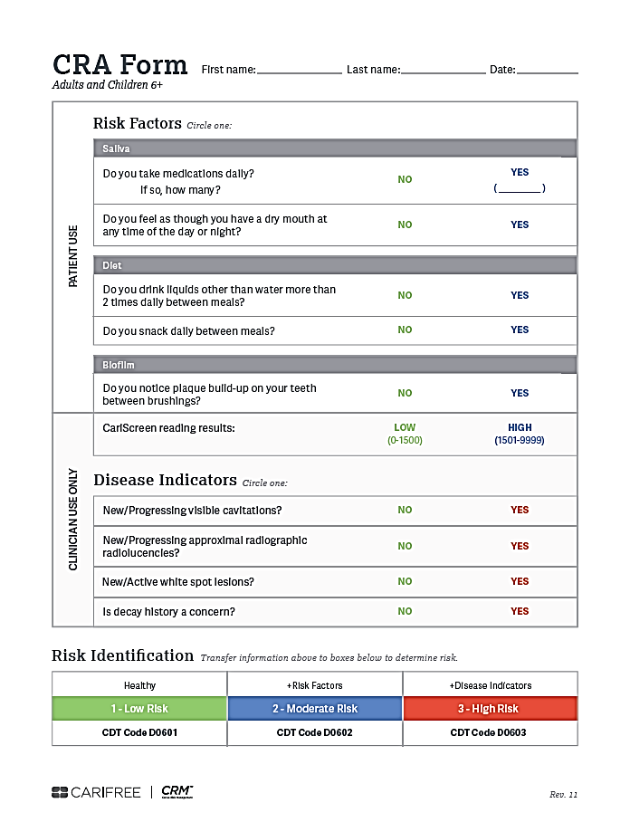
Caries Risk Assessment
D0601 Low Risk
D0602 Moderate Risk
D0603 High Risk

Slide 15
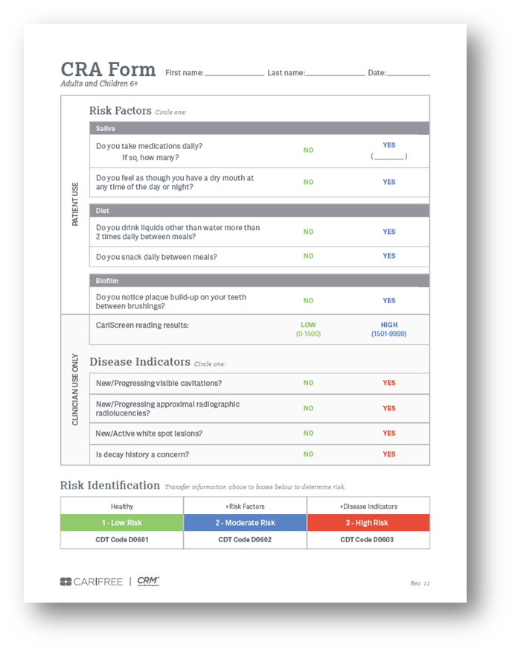
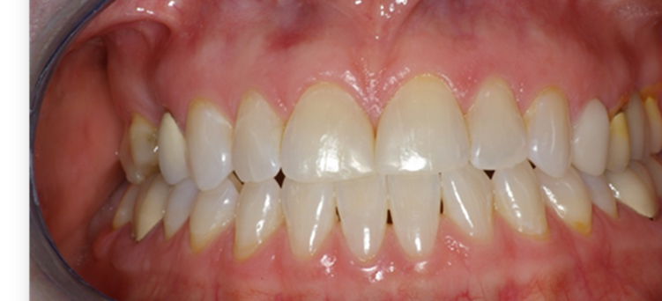
1. Do you take medications daily?
2. Do you have dry mouth?
pH
100%
PATTERN RECOGNITION
Notes:
Abstract
Objective: The present review aimed to systematically evaluate the occurrence of caries in patients with inflammatory bowel disease (IBD), either Crohn's disease (CD) or ulcerative colitis (UC), compared to healthy controls.
Materials and methods: MEDLINE (PubMed), Embase, Google Scholar, LILACS, and Cochrane Library electronic databases were screened. Caries experience was measured through the Decayed, Missing, Filled Teeth (DMFT) index. The weighted mean difference (WMD) with 95% confidence interval was calculated between IBD patients and healthy controls.
Results: Six studies were selected for the inclusion in the systematic review, 5 of which were also included in the quantitative synthesis of data. The WMD in the DMFT index between IBD and healthy subjects was 3.04 (1.52, 4.56) (p = 0.10). Subgroup analysis showed no difference (p = 0.31) between CD (2.52 [0.54, 4.49]) and UC (4.01 [1.52, 4.56]) subjects.
Conclusions: There is a remarkably higher past and present occurrence of dental caries in subjects with IBD than healthy controls. This result should encourage clinicians to include oral health preventive programs in the overall treatment plan of IBD patients.
10

Slide 16
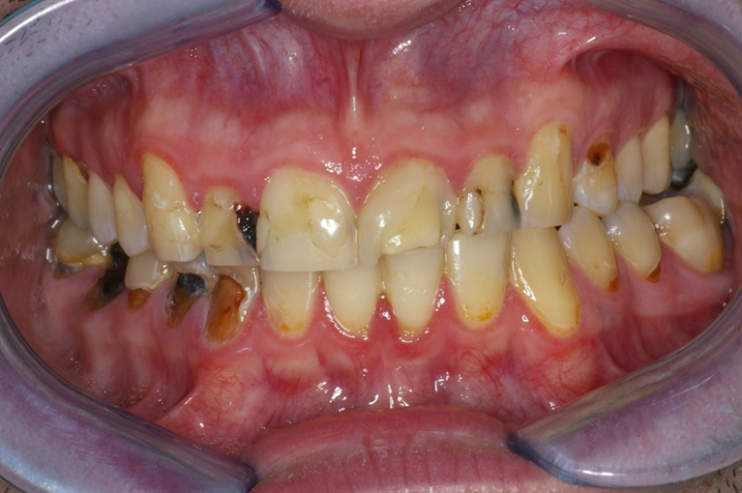
Do you drink liquids, other than water, more than 2 times per day, between meals?
Diet
55%
pH
100%
Saliva
63%
PATTERN RECOGNITION
Notes:
Abstract
Objective: The present review aimed to systematically evaluate the occurrence of caries in patients with inflammatory bowel disease (IBD), either Crohn's disease (CD) or ulcerative colitis (UC), compared to healthy controls.
Materials and methods: MEDLINE (PubMed), Embase, Google Scholar, LILACS, and Cochrane Library electronic databases were screened. Caries experience was measured through the Decayed, Missing, Filled Teeth (DMFT) index. The weighted mean difference (WMD) with 95% confidence interval was calculated between IBD patients and healthy controls.
Results: Six studies were selected for the inclusion in the systematic review, 5 of which were also included in the quantitative synthesis of data. The WMD in the DMFT index between IBD and healthy subjects was 3.04 (1.52, 4.56) (p = 0.10). Subgroup analysis showed no difference (p = 0.31) between CD (2.52 [0.54, 4.49]) and UC (4.01 [1.52, 4.56]) subjects.
Conclusions: There is a remarkably higher past and present occurrence of dental caries in subjects with IBD than healthy controls. This result should encourage clinicians to include oral health preventive programs in the overall treatment plan of IBD patients.
14

Slide 17
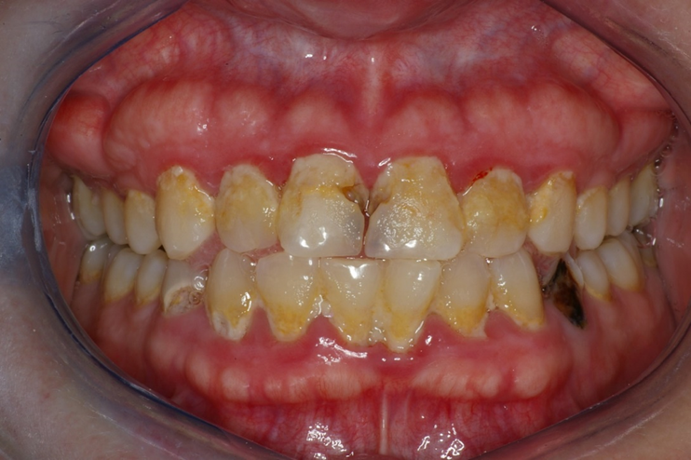
Do you notice plaque build up between
brushing your teeth?
pH
100%
PATTERN RECOGNITION
Notes:
Abstract
Objective: The present review aimed to systematically evaluate the occurrence of caries in patients with inflammatory bowel disease (IBD), either Crohn's disease (CD) or ulcerative colitis (UC), compared to healthy controls.
Materials and methods: MEDLINE (PubMed), Embase, Google Scholar, LILACS, and Cochrane Library electronic databases were screened. Caries experience was measured through the Decayed, Missing, Filled Teeth (DMFT) index. The weighted mean difference (WMD) with 95% confidence interval was calculated between IBD patients and healthy controls.
Results: Six studies were selected for the inclusion in the systematic review, 5 of which were also included in the quantitative synthesis of data. The WMD in the DMFT index between IBD and healthy subjects was 3.04 (1.52, 4.56) (p = 0.10). Subgroup analysis showed no difference (p = 0.31) between CD (2.52 [0.54, 4.49]) and UC (4.01 [1.52, 4.56]) subjects.
Conclusions: There is a remarkably higher past and present occurrence of dental caries in subjects with IBD than healthy controls. This result should encourage clinicians to include oral health preventive programs in the overall treatment plan of IBD patients.
18

Slide 18
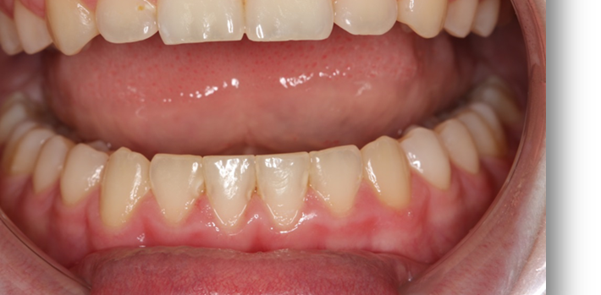
?
pH
100%
PATTERN RECOGNITION
Notes:
Abstract
Objective: The present review aimed to systematically evaluate the occurrence of caries in patients with inflammatory bowel disease (IBD), either Crohn's disease (CD) or ulcerative colitis (UC), compared to healthy controls.
Materials and methods: MEDLINE (PubMed), Embase, Google Scholar, LILACS, and Cochrane Library electronic databases were screened. Caries experience was measured through the Decayed, Missing, Filled Teeth (DMFT) index. The weighted mean difference (WMD) with 95% confidence interval was calculated between IBD patients and healthy controls.
Results: Six studies were selected for the inclusion in the systematic review, 5 of which were also included in the quantitative synthesis of data. The WMD in the DMFT index between IBD and healthy subjects was 3.04 (1.52, 4.56) (p = 0.10). Subgroup analysis showed no difference (p = 0.31) between CD (2.52 [0.54, 4.49]) and UC (4.01 [1.52, 4.56]) subjects.
Conclusions: There is a remarkably higher past and present occurrence of dental caries in subjects with IBD than healthy controls. This result should encourage clinicians to include oral health preventive programs in the overall treatment plan of IBD patients.
22

Slide 19
Diet
55%
Biofilm
46-51%
Genetics
9%
pH
100%
Saliva
63%
PATTERN RECOGNITION
Notes:
Abstract
Objective: The present review aimed to systematically evaluate the occurrence of caries in patients with inflammatory bowel disease (IBD), either Crohn's disease (CD) or ulcerative colitis (UC), compared to healthy controls.
Materials and methods: MEDLINE (PubMed), Embase, Google Scholar, LILACS, and Cochrane Library electronic databases were screened. Caries experience was measured through the Decayed, Missing, Filled Teeth (DMFT) index. The weighted mean difference (WMD) with 95% confidence interval was calculated between IBD patients and healthy controls.
Results: Six studies were selected for the inclusion in the systematic review, 5 of which were also included in the quantitative synthesis of data. The WMD in the DMFT index between IBD and healthy subjects was 3.04 (1.52, 4.56) (p = 0.10). Subgroup analysis showed no difference (p = 0.31) between CD (2.52 [0.54, 4.49]) and UC (4.01 [1.52, 4.56]) subjects.
Conclusions: There is a remarkably higher past and present occurrence of dental caries in subjects with IBD than healthy controls. This result should encourage clinicians to include oral health preventive programs in the overall treatment plan of IBD patients.
24

Slide 20
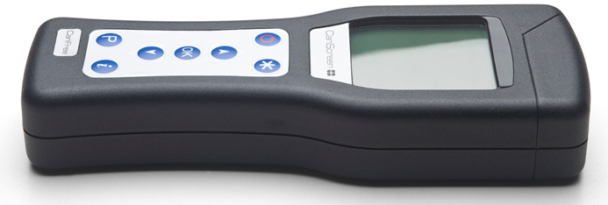
Biometric Test
DNA Ms, Ss, Lb, Candida spp
ATP Bioluminescence

Slide 21
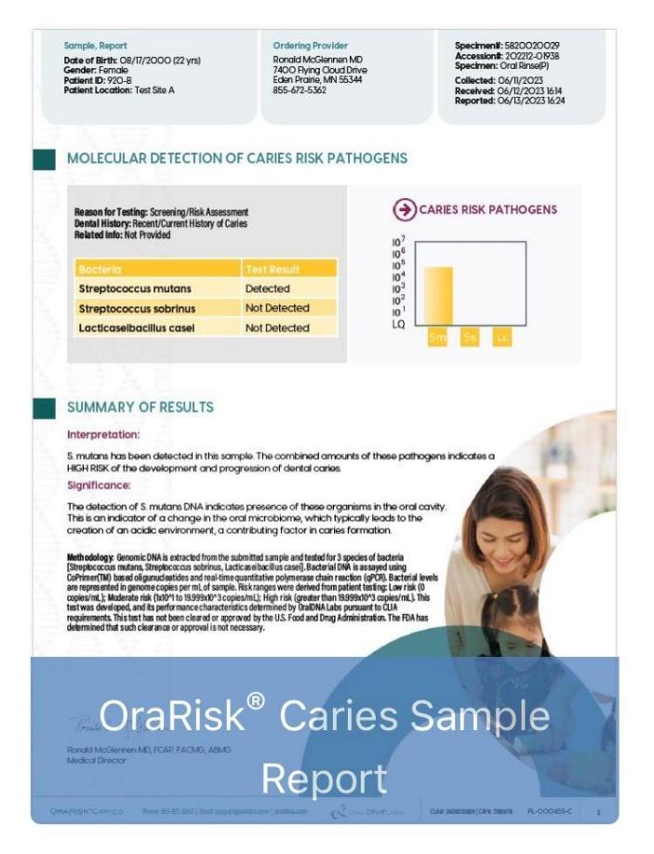
Saliva Caries Tests
OralDNA
Oral Genome
FidaLabs
MicrobeLinkDX
Bristle
OraVital

Slide 22
OraRisk Caries (OralDNA)
OraRisk® Caries
Identifies the three most common cariogenic pathogens associated with risk of developing bacterial caries

Slide 23

CariScreen
Correlates to total Biofilm load
  Ms specifically
  Whitespot lesions
  Interproximal lesions
  Adequate saliva
  Does not predict cavities

Slide 24
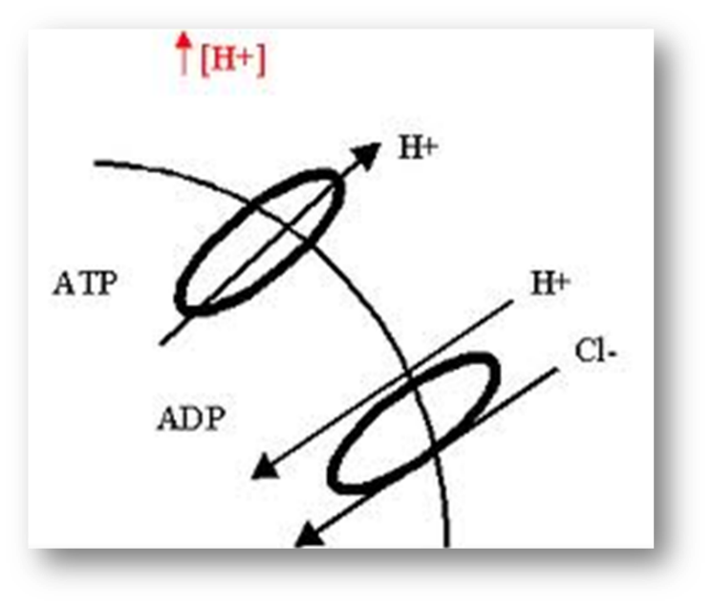
How S. mutans Survives Acidic Environments
“A key to survival of S. mutans at low pH is its ability to maintain
a transmembrane pH gradient with the interior of the cell more alkaline.
This results in an increased use of ATP for H+ extrusion and a consequent reduction in cell yield.”
Alice CL Len, Harty DWS, Jaques AJ. Stress-responsive proteins are upregulated in Streptococcus mutans during acid tolerance. Microbiol 150 (2004) 1339-1351.

Slide 25
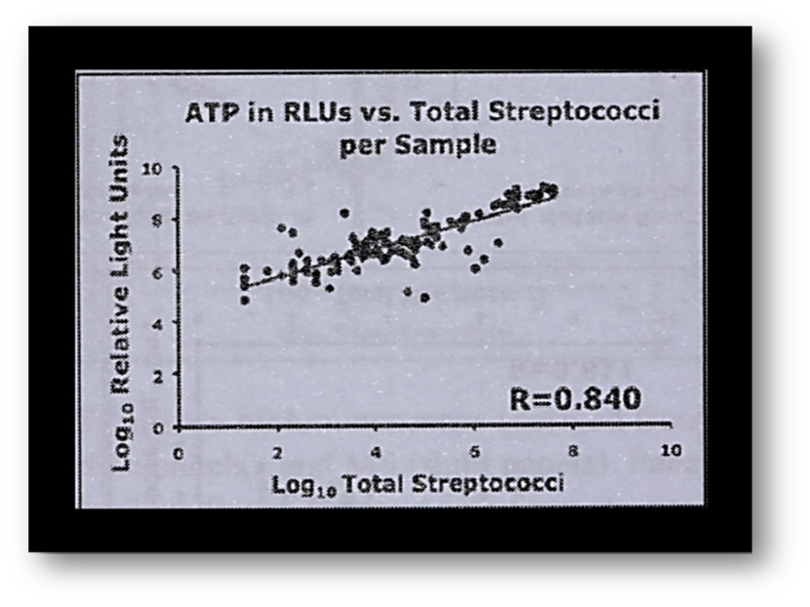
Bioluminescence May Predict Caries
“The strong statistical correlation between total oral bacteria to oral streptococci, including cariogenic streptococci, suggests that the ATP-driven bioluminescence may also potentially serve as an indirect assessment determination of dental caries risk.”
Machida CA, MaierT, Iraj Kasimi et al. Bioluminescence and Application in Dentistry, Chapter 1. Bioluminescence. David Rodgerson, Nova Sciences Publisher, 2011.

Slide 26

CariScreen Delivers Quick, Reliable Results
“Results demonstrated that the
specificity of CariScreen and caries risk test was 91.67 whereas it was 75.00
for saliva check mutans…CariScreen
and caries risk test are highly efficient
in assessing the caries risk of patients. However, the CariScreen is easy to perform and provides the result in shorter time.”
Babu V, Hegde S, Bhat S, Sargod S. Evaluation of Efficacy of Three Different Commercially Available Kit for Chairside Cariogenic Bacteria Test - Caries Risk Test, Saliva-check Mutans and CariScreen. Cureus. 2019 Dec 29;11(12):e6504. doi: 10.7759/cureus.6504. 25 5-14 yo
.

Slide 27
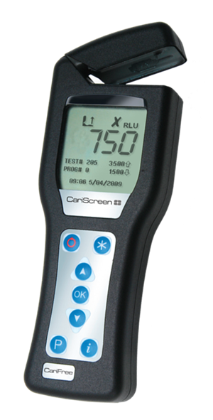
ATP-B Readings Reflect Saliva, Plaque & Lesions
“ATP-B readings was positively associated with adequate salivary flow, the risk factor heavy plaque, and two disease indicators: proximal enamel lesions and active lesions.”
Rechmann P, Chaffee BW, Rechmann BMT, Featherstone JDB. Efficacy of an adenosine triphosphate meter for evaluating caries risk in clinical dental practice. J Am Dent Assoc. 2019 Oct;150(10):873-882. doi: 10.1016/j.adaj.2019.05.025. Epub 2019 Aug 28. 460 pat 2 yrs
.

Slide 28

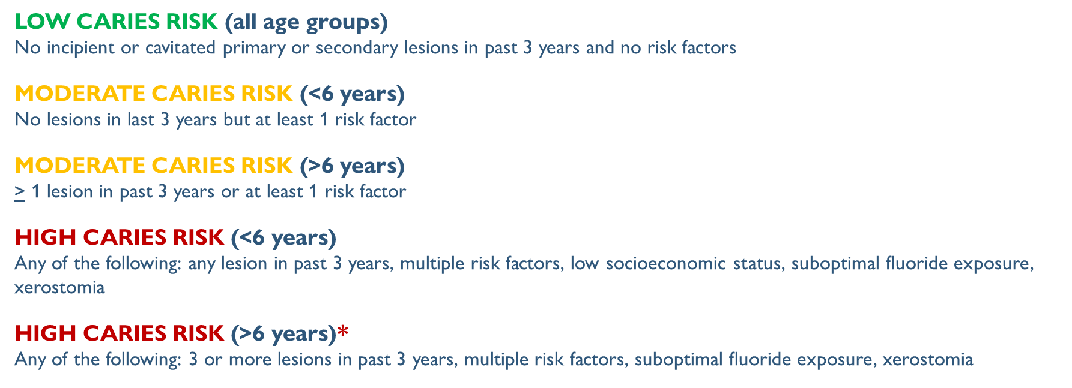
ADA Guidelines 2006 JADA

Slide 29

Caries Risk Assessment
D0601 Low Risk
D0602 Moderate Risk
D0603 High Risk

Slide 30
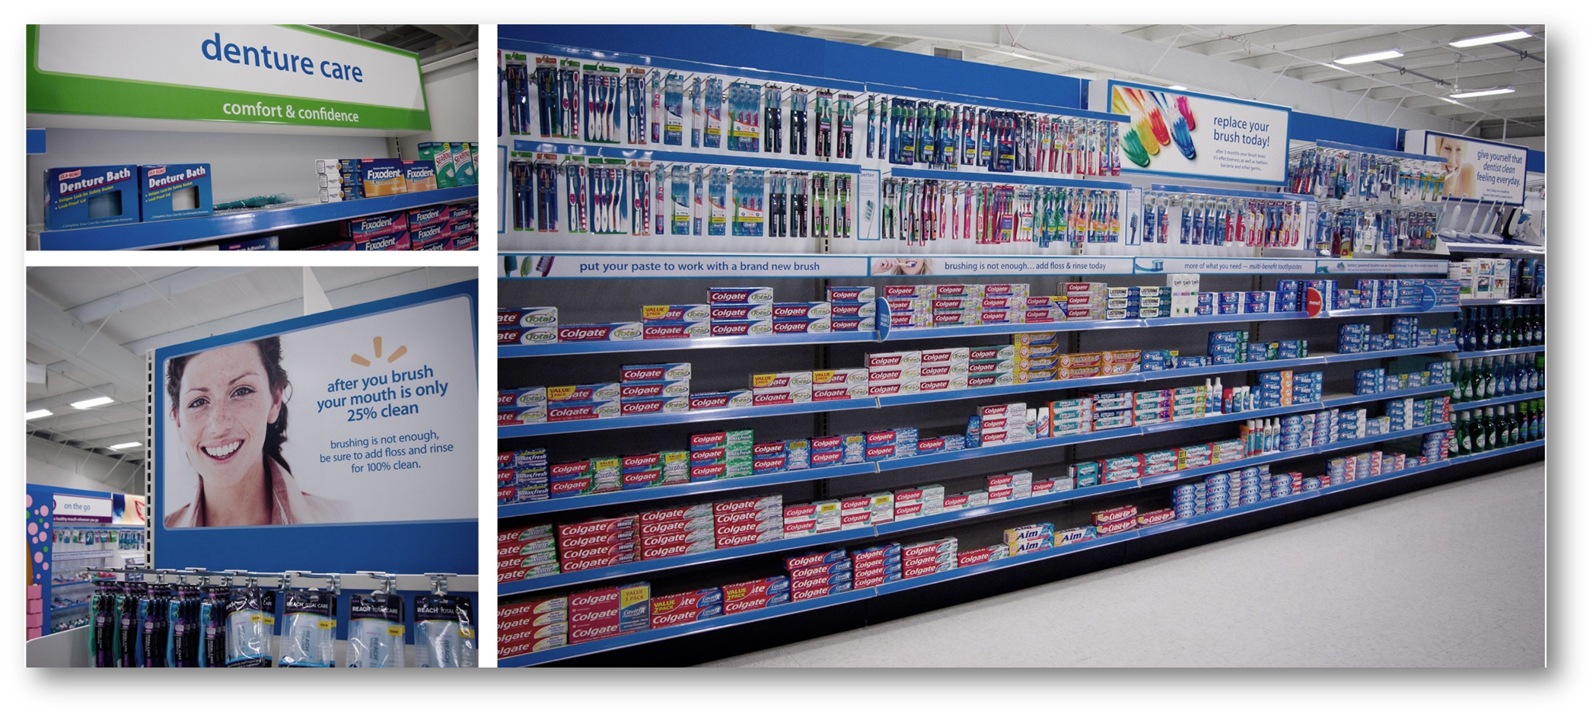
Prescribe
Notes:
Abstract
Objective: The present review aimed to systematically evaluate the occurrence of caries in patients with inflammatory bowel disease (IBD), either Crohn's disease (CD) or ulcerative colitis (UC), compared to healthy controls.
Materials and methods: MEDLINE (PubMed), Embase, Google Scholar, LILACS, and Cochrane Library electronic databases were screened. Caries experience was measured through the Decayed, Missing, Filled Teeth (DMFT) index. The weighted mean difference (WMD) with 95% confidence interval was calculated between IBD patients and healthy controls.
Results: Six studies were selected for the inclusion in the systematic review, 5 of which were also included in the quantitative synthesis of data. The WMD in the DMFT index between IBD and healthy subjects was 3.04 (1.52, 4.56) (p = 0.10). Subgroup analysis showed no difference (p = 0.31) between CD (2.52 [0.54, 4.49]) and UC (4.01 [1.52, 4.56]) subjects.
Conclusions: There is a remarkably higher past and present occurrence of dental caries in subjects with IBD than healthy controls. This result should encourage clinicians to include oral health preventive programs in the overall treatment plan of IBD patients.

Slide 31
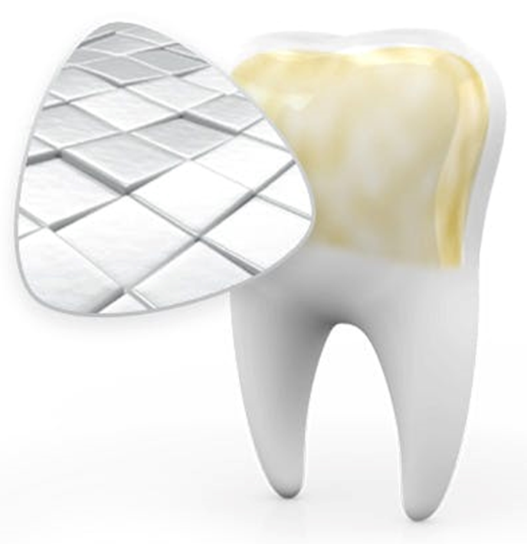
Reparative Strategies
Monitor AI?
Remineralization
  (Fl-, Nano HA, Curodont)
Sealants
ART
Restoration (Drill and Fill)

Slide 32
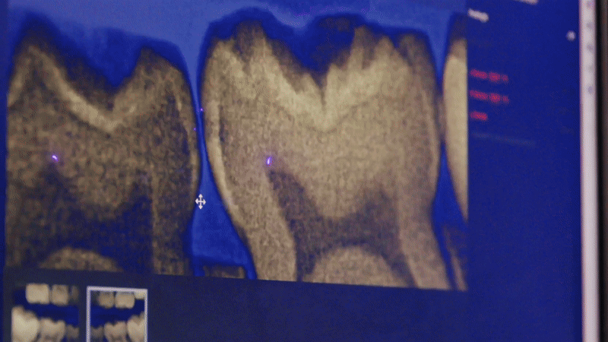
Monitor with AI Radiography Programs

Slide 33
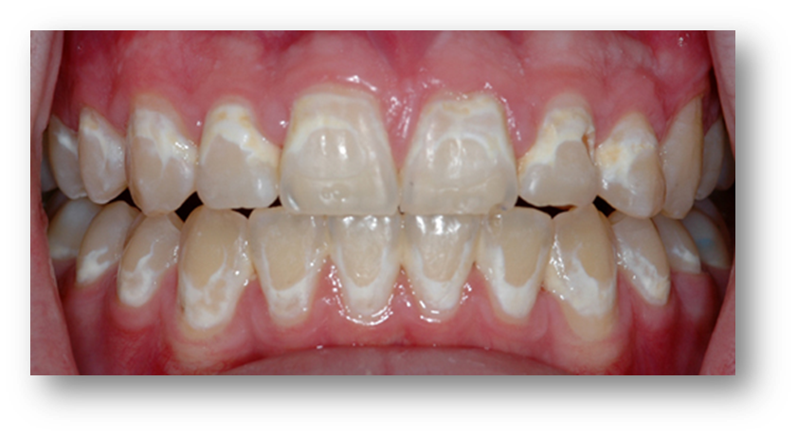
Evidence Favors Fluoride Varnish
“A 5% sodium fluoride varnish was the only therapy to show a statistically significant improvement compared with results in the control group (1100 ppm Fluoride dentifrice).”
Fernández-Ferrer L, Vicente-Ruíz M, García-Sanz V, Montiel-Company JM, Paredes-Gallardo V, et al. Enamel remineralization therapies for treating postorthodontic white-spot lesions: A systematic review. J Am Dent Assoc. 2018 Sep;149(9):778-786.
Notes:
This is a practical solution.
Practice has used Icon in some of these cases. Great esthetic results but expensive, time consuming and technique sensitive. A couple instances of recurrent caries.

Slide 34
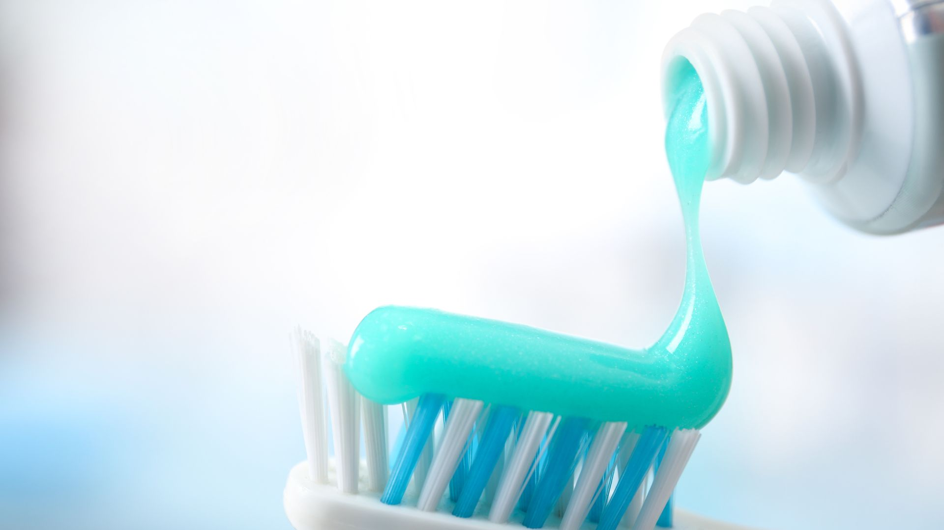
Fluoride Gels Help—Unless They’re Acidic
“Additional use of most fluoride gels/solutions significantly enhanced mineral gain, mainly in the surface area; however, acidic gels/solutions seemed to have negative effects on lesion depths…Under the present pH-cycling conditions the highly fluoridated dentifrice significantly reduced caries progression and additional application of nearly all of the fluoride gels/solutions resulted in remineralization.”
Erdwey D, Meyer-Lueckel H, Esteves-Oliveira M, Apel C, Wierichs RJ. Demineralization Inhibitory Effects of Highly Concentrated Fluoride Dentifrice and Fluoride Gels/Solutions on Sound Dentin and Artificial Dentin Caries Lesions in vitro. Caries Res. 2021;55(1):41-54. 240 Mol Ivt, 28D, AF, NaF, SDF, APF 1450, 5000, 12,500
Notes:
Abstract
Objectives: The aim of this in vitro study was to compare the demineralization inhibitory effect of gels/solutions used in combination with either standard or highly fluoridated dentifrices on sound dentin as well as on artificial dentin caries-like lesions.
Methods: Bovine dentin specimens (n = 240) with two different surfaces each (sound [ST] and artificial caries lesion [DT]) were prepared and randomly allocated to twelve groups. Weekly interventions during pH-cycling (28 days, 6 × 120 min demineralization/day) were: the application of gels/solutions containing amine fluoride/sodium fluoride (12,500 ppm F [ppm]; pH = 4.4; AmF); NaF (12,500 ppm; pH = 6.6; NaF1); NaF (12,500 ppm; pH = 6.3; NaF2); silver diamine fluoride (14,200 ppm; pH = 8.7; SDF); acidulated phosphate fluoride (12,500 ppm; pH = 3.8; APF), and no intervention (standard control; S). Furthermore, half of the specimens in each group were brushed (10 s; twice per day) with dentifrice slurries containing either 1,450 ppm (e.g., AmF1450) or 5,000 ppm (e.g., AmF5000). Differences in integrated mineral loss (ΔΔZ) and lesion depth (ΔLD) were calculated between values before and after pH-cycling using transversal microradiography.
Results: After pH-cycling Ss showed significantly increased ΔZDT and LDDT values, indicating further demineralization. In contrast, except for one, all groups including fluoride gels/solutions showed significantly decreased ΔZDT values. Additional use of most fluoride gels/solutions significantly enhanced mineral gain, mainly in the surface area; however, acidic gels/solutions seemed to have negative effects on lesion depths.
Significance: Under the present pH-cycling conditions the highly fluoridated dentifrice significantly reduced caries progression and additional application of nearly all of the fluoride gels/solutions resulted in remineralization. However, there was no difference in the remineralizing capacity of fluoride gels/solutions when used in combination with either standard or highly fluoridated dentifrices.

Slide 35
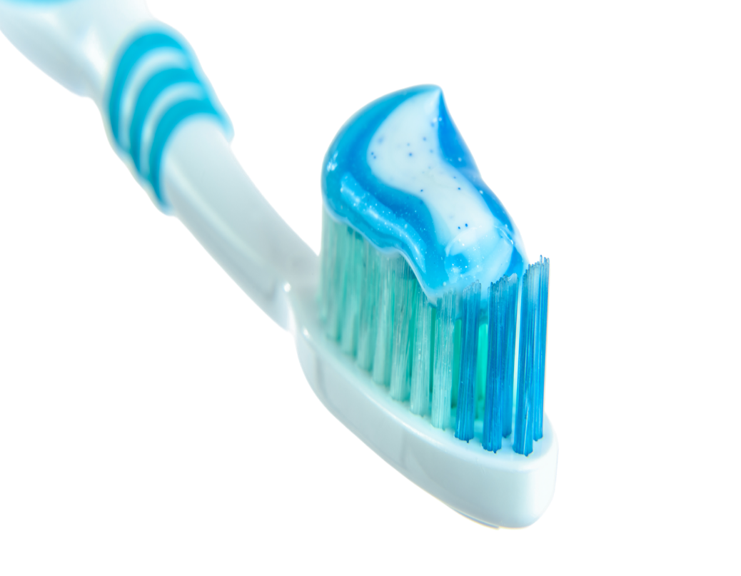
Ishizuka Y, Lehrkinder A, Nordström A, Lingström P: Effect of Different Toothbrushing Routines on Interproximal Fluoride Concentration. Caries Res 2020;54:343-349. doi: 10.1159/000510181
Toothpaste Use & Water Amount Matter
“These findings suggest that the amount of toothpaste, the duration and the amount of water have a significant effect on fluoride concentration after toothbrushing. Furthermore, despite the lower amount of fluoride, the gel gives almost the same fluoride concentration after toothbrushing as the toothpaste.” 2 cm
Notes:
Abstract
This study aimed to evaluate the effect of different toothbrushing routines and different kinds of toothpaste on the interproximal fluoride concentration after toothbrushing and its clinical relevance to the recommendations given to patients regarding the process of toothbrushing. Eight adults participated a total of 8 times in order to test different toothbrushing routines with different amounts of toothpaste (1 or 2 cm), durations (1 or 2 min) and amounts of water after toothbrushing (10 or 20 mL). An additional 8 adults participated 6 times in total to test different forms of toothpaste administration (paste, gel and foam) with different amounts of water after toothbrushing (no rinsing or 10 mL). Interdental saliva samples were collected from proximal sites 25/26 and 46/45 using small paper points, before and up to 60 min after toothbrushing. The fluoride concentration was measured by an ion-specific electrode. The area under the curve, saliva fluoride concentration versus time, was calculated. Differences between the groups were tested by ANOVA with Tukey's multiple comparisons test. An increase in fluoride concentration of 47.2% was observed when the amount of toothpaste increased from 1 to 2 cm (p < 0.01), 26.8% when increasing the duration from 1 to 2 min (p < 0.01) and 41.2% when reducing the amount of water rinsing from 20 to 10 mL (p < 0.01). The paste and gel resulted in higher fluoride concentration (p < 0.01) compared with foam. These findings suggest that the amount of toothpaste, the duration and the amount of water have a significant effect on fluoride concentration after toothbrushing. Furthermore, despite the lower amount of fluoride, the gel gives almost the same fluoride concentration after toothbrushing as the toothpaste. The results confirm the importance of giving clear advice to patients regarding the process of toothbrushing.

Slide 36
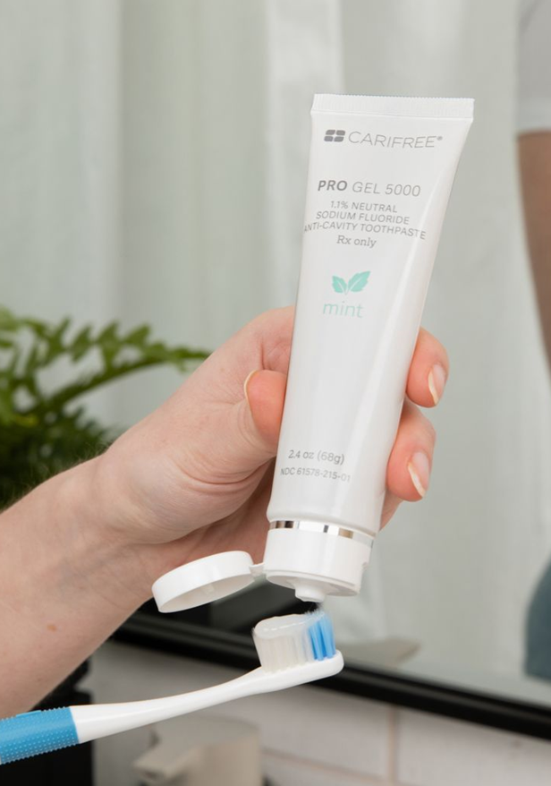
63% SMHR at 72 hours
“The %SMHR data showed the Carifree Pro Gel toothpaste formulation was able to achieve statistically significantly greater repair and protection of the enamel samples than the negative control during this treatment and pH cycling study.”
Thomas G, Badrock T, Thompson C. . An In Vitro Study to Evaluate the Ability of s Toothpaste Formulation to Repair and Protect Demineralized Enamel Samples. Interteck CRS. December 2022. S/N150-LAB-SMH-22-002.

Slide 37
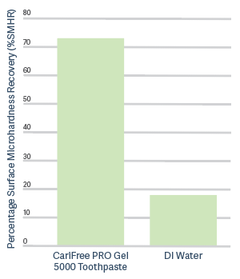
73% SMHR
According to an independent
study conducted by
Intertek, using the Huang et
al. (2009) pH-cycling model,
the CariFree PRO Gel 5000
Toothpaste significantly
enhances enamel repair
and protection, achieving
73% surface microhardness
recovery in just three days.

Slide 38
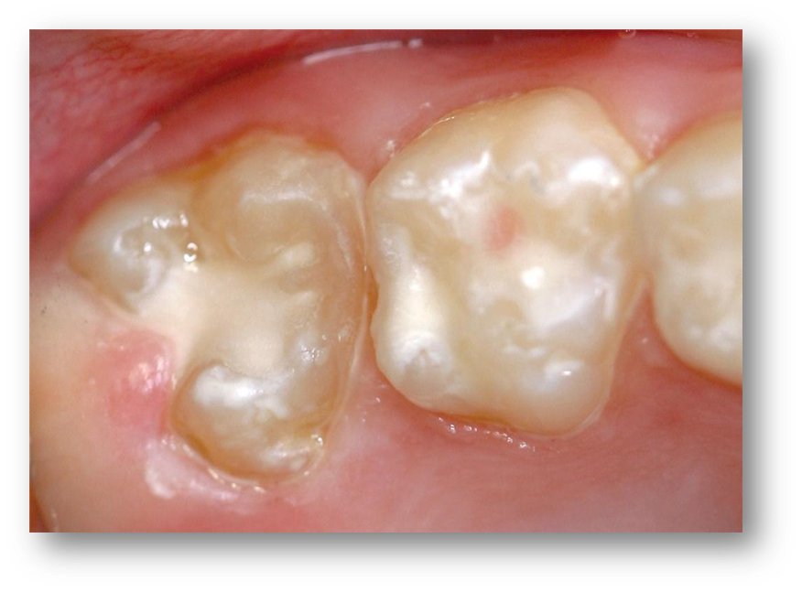
Seal It Early: Caries Prevention for Kids
“Sealed primary molars were less likely to develop pit-and-fissure caries when placed in both the clinic and operating room settings. Dental sealants on primary molars should be considered for children at high caries risk.”
Hong M, Vuong C, Herzog K, Ng MW, Sulyanto R. Sealed primary molars are less likely to develop caries. J Am Dent Assoc. 2019 Aug;150(8):641-648. doi: 10.1016/j.adaj.2019.04.011

Slide 39
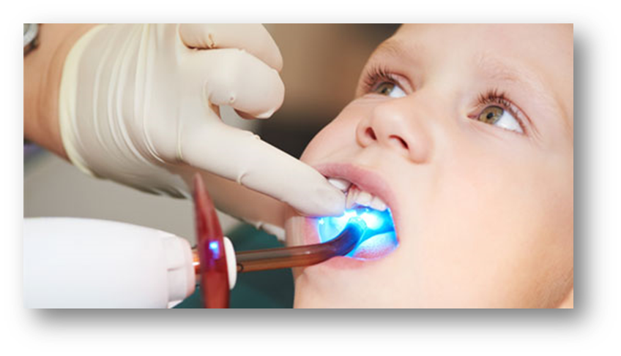
Sealants Stop Decay in Its Tracks
“However, regardless of lesion severity, sealants were 100% effective at 12 months and 98% effective over 44 months in managing noncavitated occlusal surfaces at ICDAS 0-4 levels.”
Fontana M, Platt JA, Eckert GJ, González-Cabezas C, Yoder K, et al. Monitoring of Sound and Carious Surfaces under Sealants over 44 Months. J Dent Res. 2014 Nov;93(11):1070-5. 64, 7-10 yr. 2 ICDAS 0-2

Slide 40
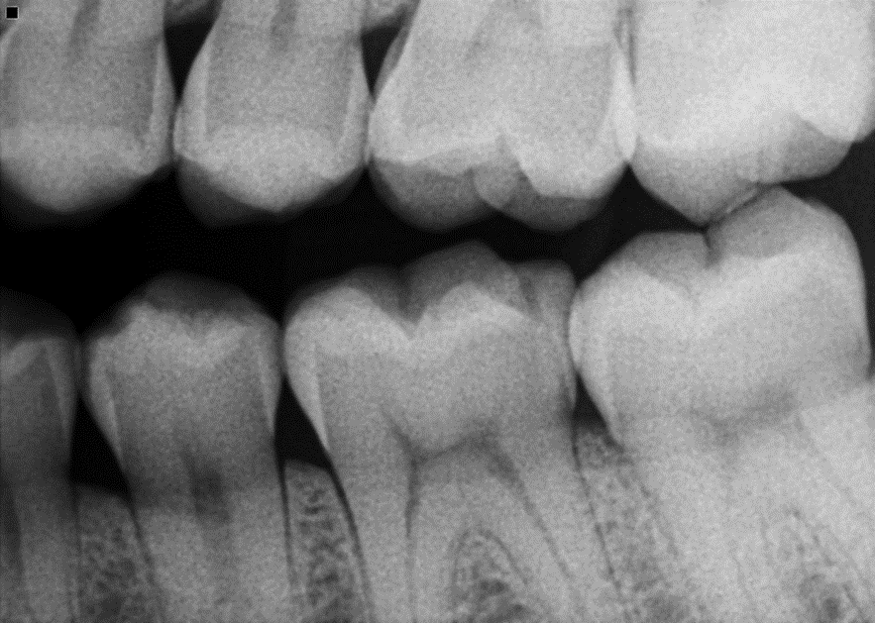
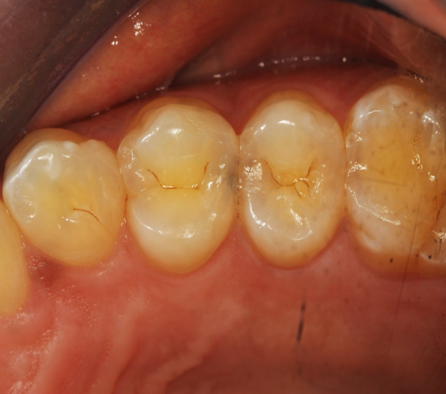
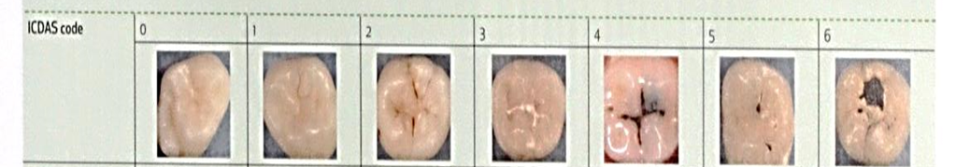
When to Remineralize

Slide 41
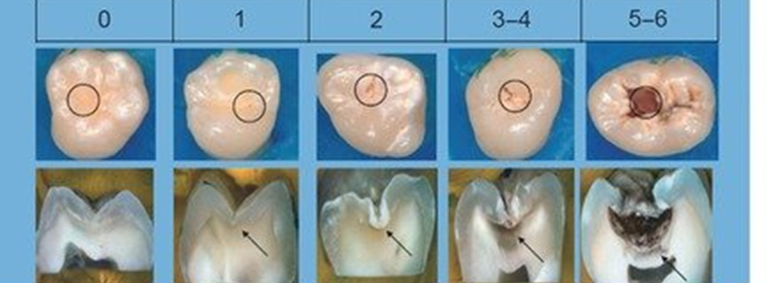
Minimally Invasive Dentistry in Action
“Treatment involved a minimally invasive dentistry approach, which consisted of remineralization via fluoride applications, placement of a composite resin restoration, microabrasion, and periodic maintenance...demonstrating the effectiveness of the ICDAS-LAA.”
ICDAS 0-4
Velo MMAC, Scotti CK, da Silveira ITT, Mondelli RFL, Atta MT, Bombonatti JF. Management of dental caries guided by the ICDAS-LAA: a 28-month follow-up. In Dent. 2019 Sep-Oct;67(5):24-28.
Notes:
n=1, dietary journal for 2 weeks,

Slide 42
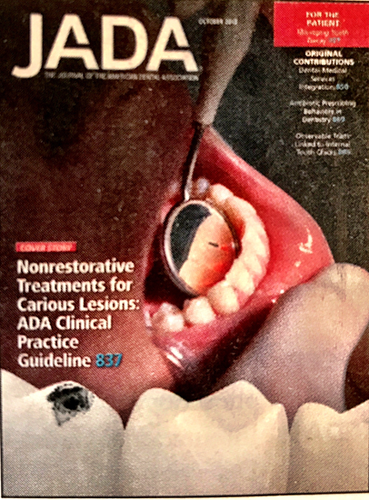

Top Evidence-Based Caries Interventions
“Of the most effective interventions, the panel provided recommendations for the use of 38% Silver Diamine Fluoride, sealants, 5% sodium fluoride varnish, 1.23% acidulated phosphate fluoride gel, and 5000 ppm fluoride toothpaste or gel, among others. The panel also provided a recommendation against the use of 10% CPP-ACP.”
Slayton RL, Urquhart O, Araujo MWB, Fontana M, Young DA, et al. Evidence-based clinical practice guideline on non-restorative treatments for carious lesions. JADA October 2018. 149(10):837-849.

Slide 43
Non-Restorative Treatment Recommendations
48 studies, 7,378 participants, 22 interventions
Sealants + fluoride varnish or
5000 ppm fluoride gel
(for noncavitated occ, prox, and root caries)
5% fluoride varnish
(noncavitated facial/lingual)
38% SDF (advanced cavitated coronal)
Urquhart O, Tampi MP, Pilcher L, Slayton RL, Araujo MWB, et al. Nonrestorative Treatments for Caries: Systematic Review and Network Meta-analysis. J Dent Res. January 2019. 98(1):12-26.
Notes:
Abstract
Background: Dental caries risk factors have been expanded to not only emphasize biology, dietary and oral habits but also broader social determinants such as socioeconomic factors and the utilization of health services. The aim was to review sociobehavioural/cultural and socioeconomic determinants of dental caries in children residing in the Middle East and North Africa (MENA) region.
Methods: A search was conducted in the PubMed/Medline database and Google Scholar to identify studies published from 2000 to 2019 covering children using key search terms. In the initial stages, titles, abstracts and, if needed, full articles were screened for eligibility. In the final stage, all included articles were reassessed and read, and relevant data were extracted.
Results: Out of 600 initial articles, a total of 77 were included in this review, of which 74 were cross-sectional, 2 were longitudinal and one was a case-control study. The studies included a total of 94,491 participants in 14 countries across the MENA region. A majority used the World Health Organization scoring system to assess dental caries. The caries prevalence ranged between 17.2% and 88.8%, early childhood caries between 3% and 57% and decayed missing filled teeth (dmft) varied between 0.6 and 8.5 across the various age groups. Increased age, low maternal education, low overall socioeconomic status, decreased frequency of tooth brushing, low parental involvement, poor oral habits, infant feeding practices and sugar consumption were among the most prevalent determinants for increased risk of caries in the reviewed studies.
Conclusions: Dental caries was found to be high among children in many of the studies published from MENA. The key determinants of dental caries were found to include factors related to child characteristics, family background, oral hygiene and infant feeding and eating habits. The high dental caries prevalence emphasises the need to address the prevailing modifiable sociobehavioural and socioeconomic determinants by translating them into effective oral health prevention policies and programmes.

Slide 44
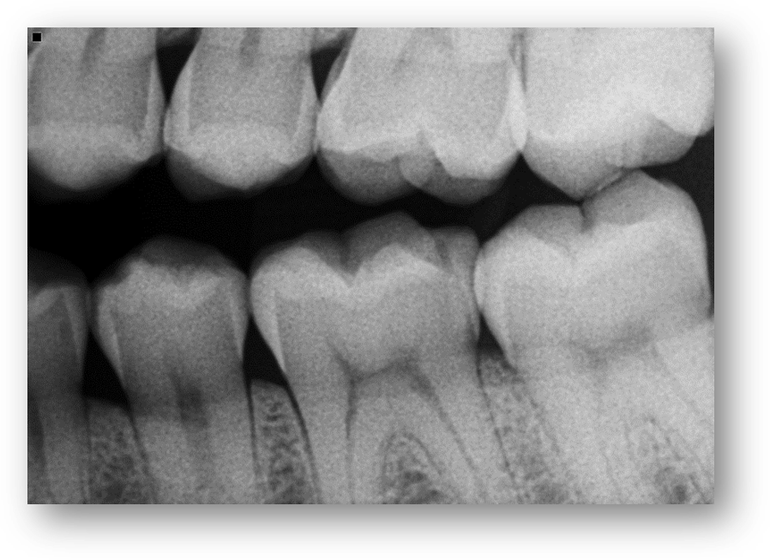
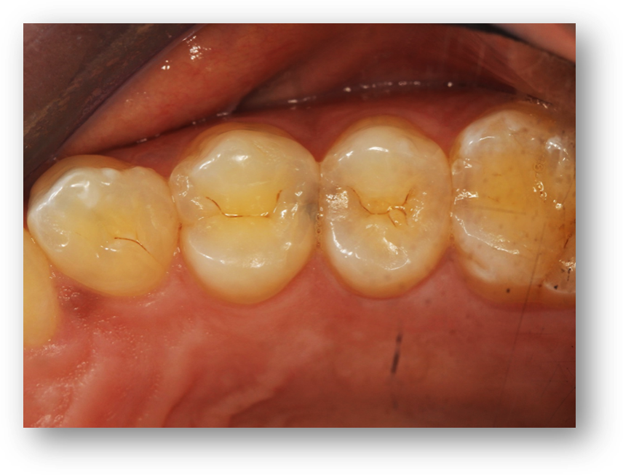
When to Monitor, Remineralize or Restore

Slide 45
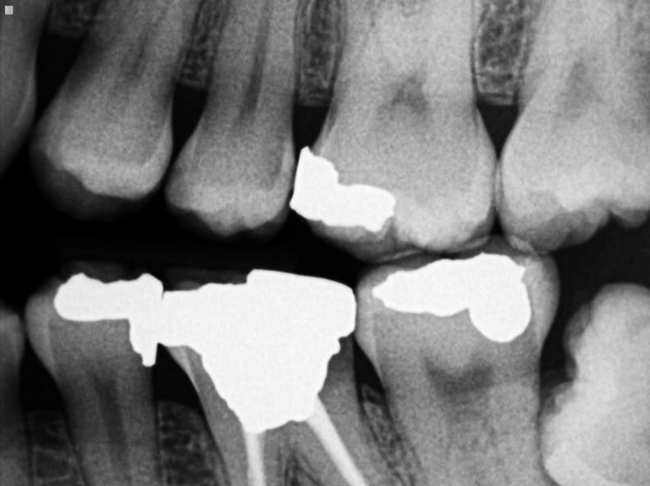
Remineralize, Don’t Restore—Yet
“Clinical evidence shows that non-cavitated caries lesions can be remineralized; therefore, early restorative treatment may no longer be necessary or appropriate. Noninvasive and minimally invasive measures should be taken into consideration.”
Rechmann P, Doméjean S, Rechmann BM, Kinsel R, Featherstone JD. Approximal and occlusal caries lesions: Restorative treatment decisions by California dentists. J Am Dent Assoc. 2016 Feb 9. pii: S0002-8177(15)01037-5. doi: 10.1016/j.adaj.2015.10.006. [Epub ahead of print
Notes:
45
Abstract
BACKGROUND:
Investigators use questionnaire surveys to evaluate treatment philosophies in dental practices. The aim of this study was to evaluate the management strategies California dentists use for approximal and occlusal caries lesions.
METHODS:
In May 2013, the authors e-mailed a questionnaire that addressed approximal and occlusal caries lesion management (detection and restorative threshold, preferred preparation type, and restorative materials) to 16,960 dentists in California. The authors performed a χ2 statistical analysis to investigate the relationship between management strategies and respondent demographic characteristics.
RESULTS:
The authors received responses from 1,922 (11.3%) dentists; 42.6% of the respondents would restore approximal lesions at the dentinoenamel junction, and 33.4% would wait until the lesion reached the outer one-third of dentin. The preferred preparation type was the traditional Class II preparation. Dentists who graduated more recently (20 years or less) were more likely to delay approximal restorations (P < .0001); 49.9% of the more recent graduates would wait to restore an occlusal lesion until the outer one-third of dentin was involved, and 42.6% would restore a lesion confined to enamel.
CONCLUSIONS:
There is wide variety among California dentists regarding their restorative treatment decisions, with most dentists restoring a tooth earlier than the literature would advise. More recent dental graduates were more likely to place their restorative threshold at deeper lesions for approximal caries lesions.
PRACTICAL IMPLICATIONS:
Clinical evidence shows that noncavitated caries lesions can be remineralized; therefore, early restorative treatment may no longer be necessary or appropriate. Noninvasive and minimally invasive measures should be taken into consideration.

Slide 46
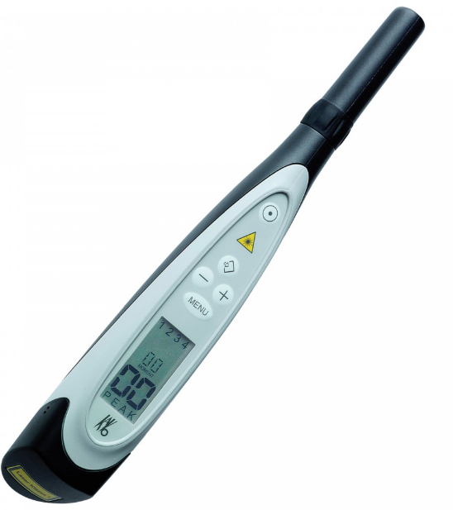
Use Adjunct Tools to Enhance Caries Detection
“ In permanent teeth, visual examination may be enhanced by DDP on occlusal surfaces and BW on approximal surfaces. In primary teeth, DDP may serve as a supplementary tool across all surfaces.”
.
Foros P, Oikonomou E, Koletsi D, Rahiotis C. Detection Methods for Early Caries Diagnosis: A Systematic Review and Meta-Analysis. Caries Res. 2021;55(4):247-259. 22964>51
Notes:
Abstract
The aim was to appraise the evidence on the performance of various means for the detection of incipient caries in vivo. Five databases of published and unpublished research were searched for studies from January 2000 to October 2019. Search terms included "early caries" and "caries detection." Inclusion criteria involved diagnostic test accuracy studies for early caries detection in permanent and primary teeth. A risk-of-bias assessment was performed using the QUADAS-2 tool. We performed the study selection, data extraction, and risk-of-bias assessment in duplicate. The review protocol was a priori registered in the Open Science Framework. Of the initially 22,964 search results, 51 articles were included. For permanent teeth, when histologic examination was considered as the reference for occlusal surfaces, the sensitivity (Se) range appeared high for the DIAGNOdent Pen (DD Pen) at 0.81-0.89, followed by ICDAS-II at 0.62-1, DIAGNOdent (DD) at 0.48-1, and bitewing radiography (BW) at 0-0.29. The corresponding specificity (Sp) range was: DD Pen 0.71-0.8, ICDAS-II 0.5-0.84, DD 0.54-1, and BW 0.96-1. When operative intervention served as the reference for occlusal surfaces, again, the DD means valued the most promising results on Se: DD 0.7-0.96 and DD Pen 0.55-0.90, followed by ICDAS-II 0.25-0.93, and BW 0-0.83. The Sp range was: DD 0.54-1, DD Pen 0.71-1, ICDAS-II 0.44-1, and BW 0.6-1. For approximal surfaces, the Se was: BW 0.75-0.83, DD Pen 0.6, and ICDAS-II 0.54; the Sp was: BW 0.6-0.9, DD Pen 0.2, and ICDAS-II 1. For primary teeth, under the reference of histologic assessment, the Se range for occlusal surfaces was: DD 0.55-1, DD Pen 0.63-1, ICDAS-II 0.42-1, and BW 0.31-0.96; the respective Sp was: DD 0.5-1, DD Pen 0.44-1, ICDAS-II 0.61-1, and BW 0.79-0.98. For approximal surfaces, the Se range was: DD Pen 0.58-0.63, ICDAS-II 0.42-0.55, and BW 0.14-0.71. The corresponding Sp range was: DD Pen 0.85-0.87, ICDAS-II 0.73-0.93, and BW 0.79-0.98. Se and Sp values varied, due to the heterogeneity regarding the setting of individual studies. Evidently, robust conclusions cannot be drawn, and different diagnostic means should be used as adjuncts to clinical examination. In permanent teeth, visual examination may be enhanced by DD on occlusal surfaces and BW on approximal surfaces. In primary teeth, DD Pen may serve as a supplementary tool across all surfaces.

Slide 47
DIAGNOdent Pen vs. Bitewing
(Permanent Teeth with Histology)
1. Occlusal Surfaces:
DDP: Sensitivity 0.81-0.89; Specificity 0.71-0.80
BWX: Sensitivity 0.0-0.29; Specificity 0.96-1.0
2. Approximal Surfaces:
DDP: Sensitivity 0.60; Specificity 0.20
BWX: Sensitivity 0.75-0.83; Specificity 0.60-0.90

Slide 48
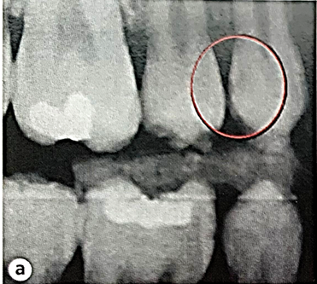
Better Detection, Less Intervention
“Combining detection methods seems desirable to increase the accuracy in assessing approximal posterior lesions. The low proportion of cavitated lesions reinforces the idea of cautiously indicating invasive approaches for managing proximal carious lesions.”
Muñoz-Sandoval C, Gambetta-Tessini K, Botelho JN, Giacaman RA. Detection of Cavitated Proximal Carious Lesions in Permanent Teeth: A Visual and Radiographic Assessment. Caries Res. 2022;56(3):171-178.
Notes:
Abstract
Detection of proximal carious lesions involves the combination of clinical and radiographic methods, both with inherent difficulties. The present cross-sectional study is aimed at estimating the prevalence of cavitation in proximal carious lesions, based on a direct clinical assessment of previously detected radiographic lesions, in permanent molars and premolars. Proximal dental surfaces were radiographically evaluated using the ADA coding system and cavitation was determined through clinical visual examination of the surfaces after separation with elastomeric bands. One-hundred and twenty-six patients attending the dental clinics at the University of Talca were examined, comprising 508 proximal surfaces with radiographic codes ranging from E1 to D3. Two examiners were trained and calibrated for radiographic and clinical detection of proximal lesions. Most participants were females (61.9%). The age mean of participants was 28.7 (0.8) years old. A total of 22.2% of the examined surfaces were cavitated. Only few lesions coded as E1 (n = 4; 2.1%) and E2 (n = 9; 9.8%) were cavitated. Fifty D1 (35.5%) and 22 D2 (41.5%) lesions were cavitated after separation. Most lesions coded as D3 (n = 28; 84.8%) were cavitated. The multilevel binary regression model (p = 0.003) demonstrated that sex, age, jaw, tooth type, surface, and side were not associated with the likelihood of having proximal cavitation. Challenging conventional wisdom, most D1 and D2 lesions were not cavitated. Combining detection methods seems desirable to increase the accuracy in assessing approximal posterior lesions. The low proportion of cavitated lesions reinforces the idea of cautiously indicating invasive approaches for managing proximal carious lesions.

Slide 49
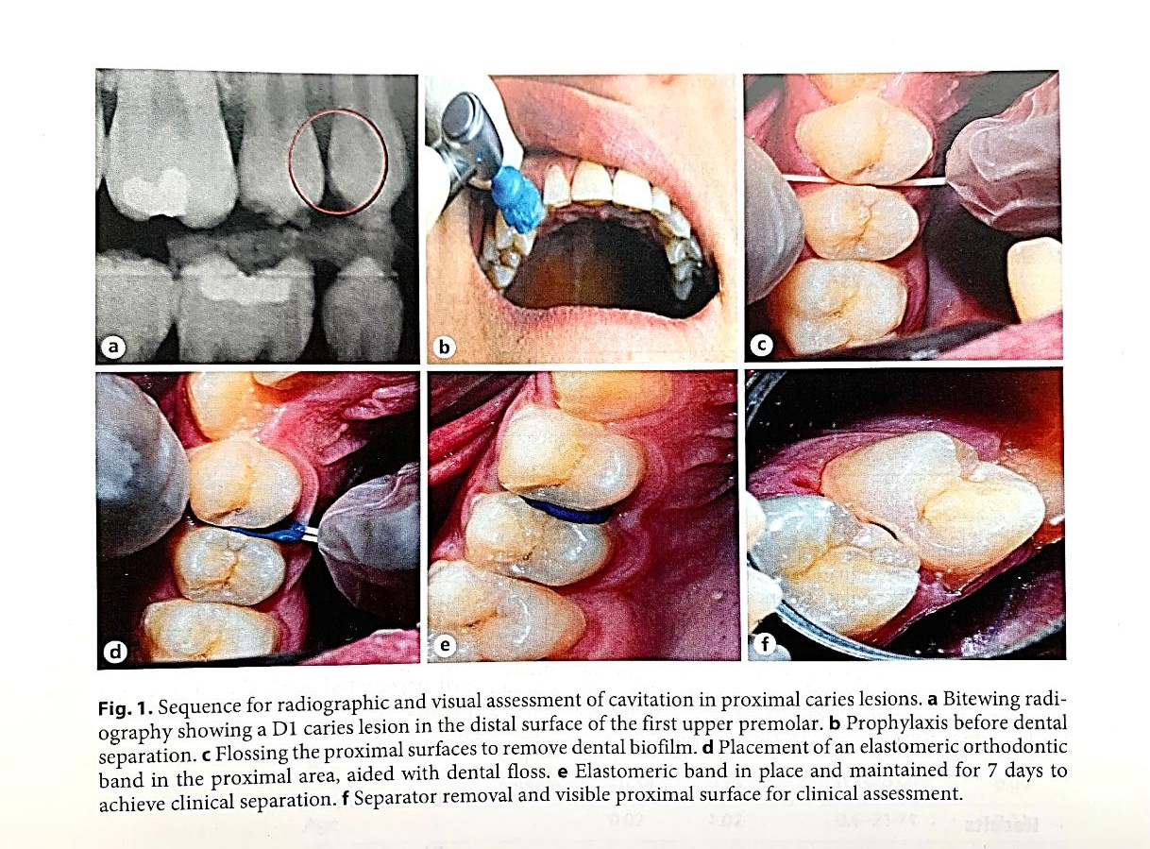
Muñoz-Sandoval C, Gambetta-Tessini K, Botelho JN, Giacaman RA. Detection of Cavitated Proximal Carious Lesions in Permanent Teeth: A Visual and Radiographic Assessment. Caries Res. 2022;56(3):171-178.

Slide 50
Proximal Lesion Depth Matters
508 proximal surfaces: E1-D3, 22.2% were cavitated
E1: n=4 2.1% were cavitated
E2: n=9 9.8% were cavitated
D1: n=50 35.5% were cavitated
D2: n=22 41.5% were cavitated
D3: n=28 84.8% were cavitated
Muñoz-Sandoval C, Gambetta-Tessini K, Botelho JN, Giacaman RA. Detection of Cavitated Proximal Carious Lesions in Permanent Teeth: A Visual and Radiographic Assessment. Caries Res. 2022;56(3):171-178.
Notes:
Abstract
Detection of proximal carious lesions involves the combination of clinical and radiographic methods, both with inherent difficulties. The present cross-sectional study is aimed at estimating the prevalence of cavitation in proximal carious lesions, based on a direct clinical assessment of previously detected radiographic lesions, in permanent molars and premolars. Proximal dental surfaces were radiographically evaluated using the ADA coding system and cavitation was determined through clinical visual examination of the surfaces after separation with elastomeric bands. One-hundred and twenty-six patients attending the dental clinics at the University of Talca were examined, comprising 508 proximal surfaces with radiographic codes ranging from E1 to D3. Two examiners were trained and calibrated for radiographic and clinical detection of proximal lesions. Most participants were females (61.9%). The age mean of participants was 28.7 (0.8) years old. A total of 22.2% of the examined surfaces were cavitated. Only few lesions coded as E1 (n = 4; 2.1%) and E2 (n = 9; 9.8%) were cavitated. Fifty D1 (35.5%) and 22 D2 (41.5%) lesions were cavitated after separation. Most lesions coded as D3 (n = 28; 84.8%) were cavitated. The multilevel binary regression model (p = 0.003) demonstrated that sex, age, jaw, tooth type, surface, and side were not associated with the likelihood of having proximal cavitation. Challenging conventional wisdom, most D1 and D2 lesions were not cavitated. Combining detection methods seems desirable to increase the accuracy in assessing approximal posterior lesions. The low proportion of cavitated lesions reinforces the idea of cautiously indicating invasive approaches for managing proximal carious lesions.

Slide 51
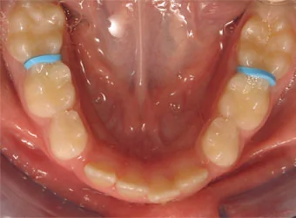
Nascimento MM, Ribeiro AP, Delgado AJ, et al. Temporary Tooth Separation to Improve Assessment of Approximal Caries Lesions: A School-Based Study. Oper Dent. 2020 Nov 1;45(6):581-588.
Rethinking Radiographic Depth as a Restorative Trigger
“Of the 206 lesions assessed…After tooth separation, 79.6% of the lesions were diagnosed as noncavitated, including 90% of the lesions radiographically at the inner half of enamel (E2) and 66% of those at the outer-third of dentin (D1). Logistic regression analysis using E2 and D1 lesions showed no significant association between lesion depth or cavitation status with lesion location and caries risk. There is a need to reevaluate the use of radiographic lesion depth as the single determinant of the restorative threshold for clinically inaccessible approximal lesions.”
Notes:
Abstract
Clinical relevance: Radiographic lesion depth should not be used as the single determinant of the restorative threshold for clinically inaccessible approximal caries lesions. Temporary tooth separation is a feasible and effective diagnostic aid for assessment and appropriate management of approximal lesions.
Summary: In the era of tooth-preserving dentistry, the decision to restore approximal caries lesions must be based on the accurate assessment of tooth cavitation, as the accumulation of oral biofilms in these areas encourages lesion progression. However, lesions radiographically into dentin remain the main threshold criterion for restoring approximal lesions even though most of these lesions may not be cavitated. A school-based clinical protocol for temporary tooth separation (TTS) was developed to improve visual-tactile assessment and management of clinically inaccessible approximal lesions. TTS data retrieved from electronic health records were used to correlate radiographic lesion depth and surface cavitation status with lesion location and the patient's caries risk and to evaluate the effectiveness of TTS as a diagnostic aid for approximal lesions. Of the 206 lesions assessed, 66.5% (n=137) were located in the maxillary arch, 56.6% (n=116) in distal surfaces, 61.3% (n=114) in premolars, and 21.5% (n=40) in molars. After tooth separation, 79.6% (n=164) of the lesions were diagnosed as noncavitated, including 90% (n=66) of the lesions radiographically at the inner half of enamel (E2) and 66% (n=49) of those at the outer-third of dentin (D1). Logistic regression analysis using E2 and D1 lesions showed no significant association between lesion depth or cavitation status with lesion location and caries risk. TTS is a feasible and effective diagnostic aid for the assessment and appropriate management of approximal caries lesions. There is a need to reevaluate the use of radiographic lesion depth as the single determinant of the restorative threshold for clinically inaccessible approximal lesions.

Slide 52
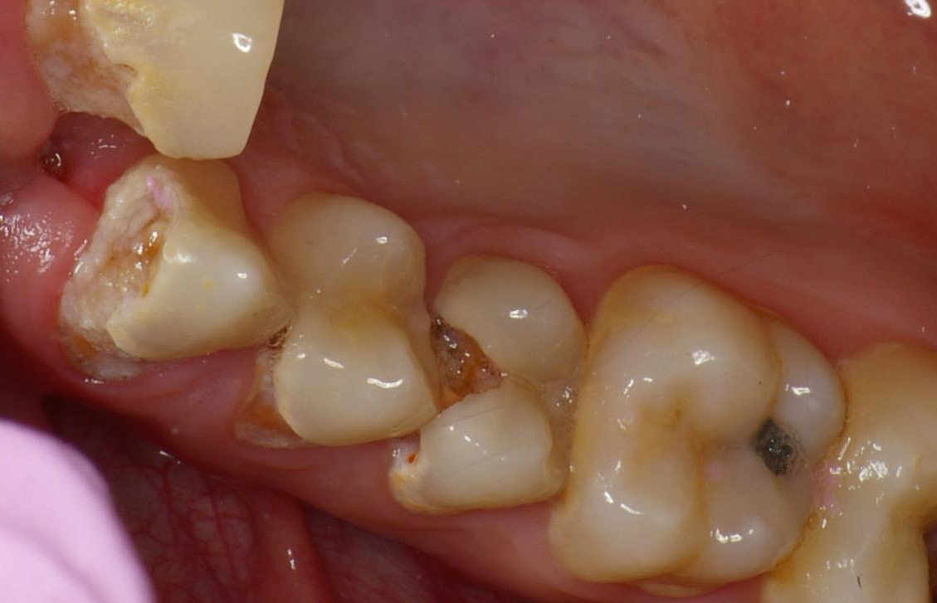
When to Restore
Cavitation is the Deciding Factor
Under Tx
vs
Over Tx

Slide 53
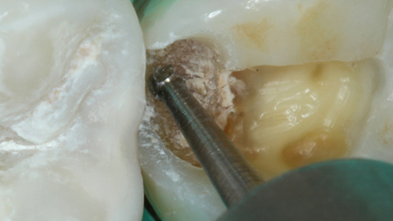
When to Stop
Infected versus Affected

Slide 54
Ricucci D, Siqueira JF Jr. Bacteriologic Status of Non-Cavitated Proximal Enamel Caries Lesions. A Histologic and Histobacteriologic Study. J Dent. 2020 Sep;100:103422.
Bacteria Can Penetrate White-Spot Lesions
“Bacterial biofilms associated with white-spot caries lesions may traverse the enamel and reach the underlying dentin in both active and arrested lesions…In non-cavitated, active or arrested, enamel caries lesions, bacteria traverse the enamel and may establish structured biofilms at the enamel-dentinal junction, causing early pulp changes.”
Notes:
Abstract
Objectives: This histologic and histobacteriologic study evaluated non-cavitated interproximal white spot lesions in human teeth for the 1) presence and morphology of bacterial aggregations at the enamel-dentinal junction (EDJ), and 2) reactions in the subjacent pulp tissue.
Methods: The material comprised 16 third molars diagnosed with early interproximal caries lesions obtained consecutively in a single clinical practice. Four third molars with clinically intact proximal surfaces served as controls. Caries activity was categorized as active or arrested. Teeth were prepared for histologic and histobacteriologic analyses.
Results: Control teeth exhibited normal tissue conditions with no bacteria. Macroscopic discoloration of the superficial dentin occurred in 14/16 teeth with early caries lesions. Bacterial aggregations resembling biofilms were observed in 10/16 teeth (six with active and four with arrested lesions). Bacterial cells were observed superficially in some of the underlying dentinal tubules, while in a few cases a deeper penetration was evident. Pathologic changes of varying degrees were observed in the pulps of all 16 teeth, regardless of the caries activity (active or arrested). Pulp reactions varied from disruption of the odontoblast layer, with loss of odontoblasts, to formation of tertiary dentin.
Conclusions: Bacterial biofilms associated with white-spot caries lesions may traverse the enamel and reach the underlying dentin in both active and arrested lesions. In all teeth with early lesions, the pulps showed changes in response to the very superficial biofilm challenge.
Clinical significance: In non-cavitated, active or arrested, enamel caries lesions, bacteria traverse the enamel and may establish structured biofilms at the enamel-dentinal junction, causing early pulp changes. These new findings may stimulate clinicians to rethink the rationale for treatment methods that are based on the assumption that bacteria are absent in white-spot lesions.

Slide 55
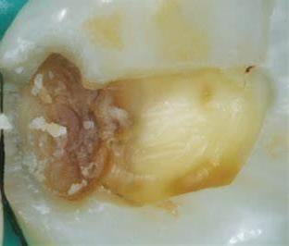
Ricucci D, Siqueira JF Jr, Rôças IN, Lipski M, Shiban A, Tay FR. Pulp and dentine responses to selective caries excavation: A histological and histobacteriological human study. J Dent. 2020 Sep;100:103430. 12 teeth exo
Leathery Dentin Still Hosts Infection
“The present study demonstrated that "leathery" or "firm" carious dentine is infected. The remnant bacteria in the dentine provoked subclinical pulpal inflammation over the entire evaluation period. The presence of potentially-arrested caries does not necessarily mean that bacterial infection is absent or under control.”
Notes:
Abstract
Objective: The present study investigated the histobacteriological condition of human carious dentine, and the histological response of dental pulps after selective caries excavation to firm dentine and cavity restoration with adhesive procedures.
Methods: Twelve vital teeth with medium/deep occlusal caries from 12 patients were scheduled for extraction. The patients gave consent to have caries removed selectively and the cavity restored with adhesive procedures prior to extraction. Caries excavation was achieved using burs and sharp hand excavators until "leathery" or "firm" dentine was encountered. After extraction, the teeth were completely-demineralised, processed for light microscopy, serial-sectioned and stained with haematoxylin and eosin staining for histological examination of dentine characteristics and pulpal responses. Additional sections were stained with Taylor-modified Brown and Brenn technique for histobacteriological examination of bacteria infiltration of the dentinal tubules and dental pulp.
Results: The 12 teeth showed varying degrees of tertiary dentine formation. Chronic inflammatory cell infiltrates were identified in the pulp of all specimens and appeared as scattered inflammatory cells or exiguous localised accumulations. Capillaries were heavily congested with erythrocytes and polymorphonuclear leukocytes. A large amount of stainable bacteria was observed in the dentine subjacent to the cavity floor in all specimens.
Conclusions: The present study demonstrated that "leathery" or "firm" carious dentine is infected. The remnant bacteria in the dentine provoked subclinical pulpal inflammation over the entire evaluation period. The presence of potentially-arrested caries does not necessarily mean that bacterial infection is absent or under control.
Clinical significance: Knowledge on the pulpal response to active caries and the inflammatory responses associated with bacteria ingress into dentine is paramount in helping clinicians make an informed, rational choice based on biologically-robust principles.

Slide 56
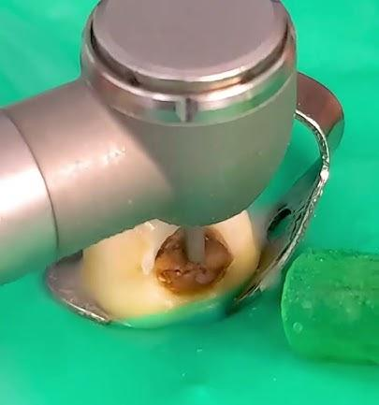
Ramezanzade S, Bjørndal L, Chen H, Baysan A. Effectiveness of Stepwise Excavation or Selective Excavation in Comparison with Non-Selective Caries Removal in Managing Deep Caries in Vital Permanent Teeth: A Systematic Review with Trial Sequential, Pairwise, and Network Meta-Analyses. Caries Res. 2026;60(1):80-109. doi: 10.1159/000545052. Epub 2025 Apr 4. PMID: 40188822. 19 Studies
Stepwise, Selective vs. Non-Selective
“However, the difference was not statistically significant. In most cases, SE was the treatment of choice in relation to carious lesion depths with the threshold of >2/3 of the dentine thickness and SW was advocated only in cooperative patients due to the two-step procedures.”
Notes:
Abstract
Objective: The present study investigated the histobacteriological condition of human carious dentine, and the histological response of dental pulps after selective caries excavation to firm dentine and cavity restoration with adhesive procedures.
Methods: Twelve vital teeth with medium/deep occlusal caries from 12 patients were scheduled for extraction. The patients gave consent to have caries removed selectively and the cavity restored with adhesive procedures prior to extraction. Caries excavation was achieved using burs and sharp hand excavators until "leathery" or "firm" dentine was encountered. After extraction, the teeth were completely-demineralised, processed for light microscopy, serial-sectioned and stained with haematoxylin and eosin staining for histological examination of dentine characteristics and pulpal responses. Additional sections were stained with Taylor-modified Brown and Brenn technique for histobacteriological examination of bacteria infiltration of the dentinal tubules and dental pulp.
Results: The 12 teeth showed varying degrees of tertiary dentine formation. Chronic inflammatory cell infiltrates were identified in the pulp of all specimens and appeared as scattered inflammatory cells or exiguous localised accumulations. Capillaries were heavily congested with erythrocytes and polymorphonuclear leukocytes. A large amount of stainable bacteria was observed in the dentine subjacent to the cavity floor in all specimens.
Conclusions: The present study demonstrated that "leathery" or "firm" carious dentine is infected. The remnant bacteria in the dentine provoked subclinical pulpal inflammation over the entire evaluation period. The presence of potentially-arrested caries does not necessarily mean that bacterial infection is absent or under control.
Clinical significance: Knowledge on the pulpal response to active caries and the inflammatory responses associated with bacteria ingress into dentine is paramount in helping clinicians make an informed, rational choice based on biologically-robust principles.

Slide 57
Summary
Start with Caries Risk Assessment
Create personalized treatment strategies based on individualized risk factors
Nonsurgical/Minimally invasive approach
When to remineralize
When to restore, when to stop drilling
Notes:
Dental caries is an endogenous microbial community-based
disease resulting from an ecological shift from dynamic stability to metabolic imbalance in a consortium of acidogenic
and aciduric bacteria comprising the dental plaque biofilm.
Participants were members of the Dunedin Multidisciplinary
Health and Development Study, a longitudinal investigation
of health and behaviour in a cohort born in Dunedin, New
Zealand. Oral biofilm samples (collected at age 32 years)
from anterior labial supragingival, posterior lingual supragingival, posterior subgingival, and the dorsum of the tongue
habitats for 841 participants were analysed using checkerboard DNA-DNA hybridisation (CKB), focussing on 30 ecologically significant bacteria. Associations of CKB data with
dental caries at ages 32 and 45 years were assessed using
regression modelling, adjusting for potential confounders
including sex, xerostomia, and oral hygiene. The putative
periodontitis pathobiont Tannerella forsythia (in the anterior
supragingival biofilm) was associated with untreated caries
at age 32 years. The percentage of total summed cell number
counts for two putative periodontitis-associated species (T.
forsythia and Micromonas micros) was associated with greater caries experience at age 32 years and the development of
new caries between age 32 and 45 years. Additionally, severe
caries (3 + cavities) was associated with putative caries
pathobionts (Lactobacillus fermentum, Lactobacillus plantarum), periodontitis-associated species, and commensals
(M. micros, Campylobacter rectus, Streptococcus mitis biovar I,
Streptococcus mitis biovar II) in the subgingival biofilm. Participants with sustained poor oral hygiene through age 32
years not only had greater experience of caries by that age
than those with good oral hygiene (fully adjusted incidence
risk ratio = 5.10, 95% CI: 3.30, 7.89) but also experienced
greater incidence of new caries from age 32 to 45 years (incidence risk ratio = 3.69, 95% CI: 2.62, 5.20). These findings
provide evidence in support of the extended caries ecological plaque hypotheses, the polymicrobial aetiology of caries,
and the integrated aetiology of dental caries and periodontal diseases. They also underscore the roles of poor oral selfcare (particularly over the life course) and xerostomia in the
occurrence and progression of caries. ©

Slide 58
Thank you!
kimkutsch@aol.com

Slide 59



Q&A CE: Blatch2
Verification Code:
BLATCHFORD
CariFree Offer
15% Off Any Product
Use Code ANY15
Not ready to order?
Scan for FREE samples
*One time use. Cannot be combined with other discounts.
Valid until 11.10.26
carifreepro.com
Don’t miss Part 3 coming November 10th
Thank you for spending the evening with us!

